Slide 1

National Network Conversation
Progression and Assessment
Summer 2022

Slide 2
Today’s session
National Network: Progression and Assessment
Introduction – brief introduction and purpose of session (5 minutes)
Video 1 – Sonny Singh, Camau i‘r Dyfodol, University of Wales Trinity Saint David (5 minutes)
Time for attendees to gather their thoughts from the preparatory activity (10 minutes)
Question 1 – It is valuable to think about how understanding of assessment in your context is changing to recognise progression within Curriculum for Wales, referring to the reflective activity you undertook in preparation for this session (40 minutes) :
  How are you using the principles of progression?
  How are you using the assessment principles to support learner progression?
  Are you thinking in new ways about assessment and progression for Curriculum for Wales? If yes, how?
Break (10 minutes)
Question 2 – What approaches to co-construction within and across schools or settings have you found effective in developing practice in planning and assessing progression? (25 minutes)
Question 3 – What forms of support would be helpful to: (20 minutes)
  Further develop professional understanding of links between progression and assessment, and
  Build capacity to develop curriculum design and assessment which supports learner progression?
Close (5 minutes)

Slide 3
Introduction
National Network: Progression and Assessment
This conversation is an opportunity to discuss what’s working well, what the barriers are to developing assessment approaches which recognise progression in your curriculum, and importantly, what has contributed to success and how barriers have been or may be overcome.
The outcomes and conclusions of this conversation will be fed directly back to Welsh Government and regional consortia and partnerships and we will work with them to develop approaches and solutions. They will also help to shape the ‘Camau i’r Dyfodol’ and ‘Assessing for the Future’ projects.

Slide 4
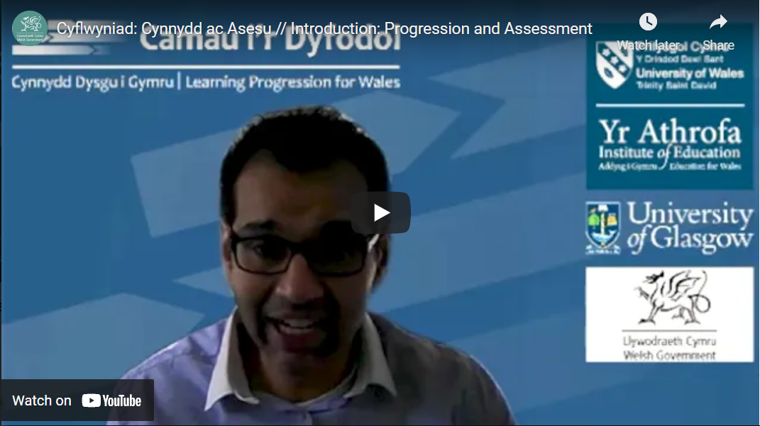
Video: Introduction
Sonny Singh, Camau i‘r Dyfodol, University of Wales Trinity Saint David
National Network: Progression and Assessment

Slide 5
It is valuable to think about how understanding of assessment in your context is changing to recognise progression within Curriculum for Wales.
Referring to the reflective activity you undertook in preparation for this session
Question 1:
National Network: Progression and Assessment
How are you using the principles of progression?
How are you using the assessment principles to support learner progression ?
Are you thinking in new ways about assessment and progression for Curriculum for Wales? If yes, how?
Notes:
Possible prompts to support Question 1, if required:
Progression
In the practice you have been thinking about, did you manage to use all the Principles of Progression?
Which did you decide to focus on? Why was that?
How did you relate the overarching Principles of Progression to the AoLE specific Principles of Progression? To what extent did they support each other? Were there any tensions?
Which principles were easier/more difficult to use? Why do you think that was the case?
Assessment
Which principles of assessment were easier/more difficult to use? Why do you think that was the case?
Are there aspects of progression which are more challenging to assess (e.g. particular AoLEs or statements of What Matters; particular Principles of Progression; learners at different stages, learning over time)?
Did you make use of the [pedagogical principles/statements of What Matters/Descriptions of Learning] to shape your assessment approaches? If so, in what ways?
What went well? What could be improved? What were the challenges?

Slide 6
National Network: Progression and Assessment
Break (10 minutes)

Slide 7
What approaches to co-construction within and across schools or settings have you found effective in developing practice in planning and assessing progression?
(30 minutes)
Question 2:
National Network: Progression and Assessment
Notes:
Possible prompts to support Question 2, if required:
With reference to your example, who was involved in planning? At what stages of the process?
To what extent and at what stages were learners involved in planning or review of these learning experiences?
How have you worked with other schools / settings to develop a shared understanding or progression and assessment? What does that look like in practice?
How can we encourage collaboration across phases to reach a shared understanding of progression?
What further opportunities to collaborate would be helpful?
To what extent does this example of practice allow for individual choice and personalisation? To what extent does it permit learners to use a variety of evidence in a variety of formats to provide evidence of their progression?

Slide 8
Question 3:
National Network: Progression and Assessment
What forms of support would be helpful to:
Further develop professional understanding of links between progression and assessment, and
Build capacity to develop curriculum design and assessment which supports learner progression?
(25 minutes)
Notes:
Possible prompts to support Question 3, if required:
How have you engaged in professional learning around progression?
Are there aspects of assessment and progression you would like to further develop your understanding of?
What types of professional learning would help develop your understanding?
What topics in this area would you find most useful for professional learning to focus on?
Are there any resources (e.g. accounts of research, other schools’ practice, professional learning, national or regional guidance) which have contributed to your thinking and planning? How were these effective/useful? Could they be improved?

Slide 9
Further resources
National Network: Progression and Assessment
Having taken part in this national network conversation, consider reflecting on:
What have you learned about how people are thinking about progression and assessment that could help with things you are currently working on?
Who, in your setting, could you involve in discussions about this?
What key messages are there in the further resources (video, article, paper for reference) that are helpful to develop:
The things you are currently working on in your setting.
Your own understanding and way of thinking about progression and assessment.
The key ideas to take away from the national network conversation.
Further resources
Video: New Welsh Curriculum – Professor Robin Banerjee talks about progression
Article: IEAN: Rethinking Learner Progression for the Future
Paper: The Curriculum for Wales – Progression Code
Notes:
Remind participants that they have further material available to support their thinking and practice.
Researchers’ views are offered in the Video: New Welsh Curriculum – Professor Robin Banerjee talks about progression and in the article: IEAN: Rethinking Learner Progression for the Future.
The Curriculum for Wales – Progression Code provides a brief clear statement of policy: in particular section 2 provides pointers to the relationship between progression and other aspects of the curriculum.
Ask if anyone has any final point they would like to add.
Express appreciation and thanks on behalf of the Government for their contribution to developing understanding and practice in assessment aligned with the aspirations of Curriculum for Wales.

Slide 10

Keep up to date on upcoming conversations and sign up to future events on Hwb.
National Network: Progression and Assessment

Slide 11
National Network: Progression and Assessment
Diolch yn fawr
Thank you

