Slide 1


Infinite scroll
Secondary lesson

Slide 2
Learning outcomes
Learners will be able to:
identify examples of infinite scroll
recognise other forms of persuasive design and their purpose
identify the problems/risks posed by persuasive design to users
consider strategies for mitigating the effects of persuasive design on technology use
understand where to seek help or support if they are concerned about their or others’ use of technology and the internet.

Slide 3

Have you ever scrolled through something online that never ends?

Slide 4

Has an app or service ever made choices on your behalf?

Slide 5


Has this ever happened to you online?

Slide 6

You finish watching a video and another one plays automatically.

Slide 7

You get a friend request on a social media app.

Slide 8

You get a notification on your device reminding you to log in to a game for a reward.

Slide 9

An app suggests a new artist to listen to based on the music you like.

Slide 10

A website emails you to remind you that you have items in your basket.

Slide 11


You scroll down a webpage and new stories keep appearing.

Slide 12




Persuasive design
--- ------ ---- -- ?

Slide 13
Persuasive techniques
Name | Method | Purpose
Infinite scroll | Automatically loading new content as you scroll down the page so that you never reach the end. | Encourages users to interact with more posts for longer. Increases opportunities to show adverts.
Variable reward | Encourage users to repeat behaviours for the chance of seeing something they like or enjoy. | Stimulates dopamine in the brain, which reinforces habitual behaviours. Encourages users to interact regularly.
Notifications | Sending notifications, vibration or visual reminders to convey an ‘important message’. | Quickly attract user attention back to an app/device. Encourages users to interact regularly.
Use of colour | Using red circles as app icon notifications and bold colours on buttons. | Quickly attract user attention back to an app. Encourages users to press certain buttons/functions.
Leading decisions | Making ‘I accept’ or ‘Okay’ buttons larger or more prominent than other options. | Encourages user to agree to terms quickly. Makes it harder for a user to decline.

Slide 14
Persuasive techniques
Name | Method | Purpose
No saving | Designing games to feature long stretches where progress cannot be saved midway. | Encourages longer playtime in order for users to succeed. Social obligation – you don’t want to let your team down by leaving early.
Clickbait | Stories or videos with misleading or extreme titles deliberately designed to grab attention or evoke emotion. | Encourages views and interactions. Increases opportunities to display advertising.
Autoplay | Automatically queues up another video (next episode or related video) for users to keep watching. | Encourages longer viewing – better stats for the platform. Increases opportunities to display advertising.
FoMO (Fear of Missing Out) | Offering time-limited deals or encouraging users to interact for fear of missing something. | Increased opportunities for selling digital products. Encourages user interactions which generate more data.
Social obligation | Encouraging users to interact or respond (for example two blue ticks on WhatsApp, Snapchat streaks, ‘likes’ and reactions). | Can pressure users into interacting for fear of upsetting others/looking bad. Encourages user interactions which generate more data.

Slide 15



What are the risks?
Technique
Notifications | Greater device use could lead to headaches or sore eyes. | Might increase anxiety – worry if notifications aren’t checked or responded to. Difficult to focus attention on other things if notifications are frequent. | Unhealthy habits – could encourage regular checking of app/device. Sleep – could interrupt good-quality sleep if notifications occur at night.
Copy the table and consider the risks of three different persuasive design techniques.

Slide 16

The Children’s code
Companies are now obligated to take greater action to protect children’s privacy online.
This also includes not using negative ‘nudge’ techniques – where companies may use large buttons or tick boxes to encourage children to make poor privacy choices.
But companies could use positive nudge techniques – like showing you a message to encourage you to take a break from playing a game.

Slide 17

Does the Children’s code go far enough?

Slide 18

Striking a balance
Look at the persuasive design techniques again.
How could we reduce their effects?
Technical strategies
Behavioural strategies
Turn them off in the device settings.
Put your device in a different room when not
in use.
Notifications

Slide 19

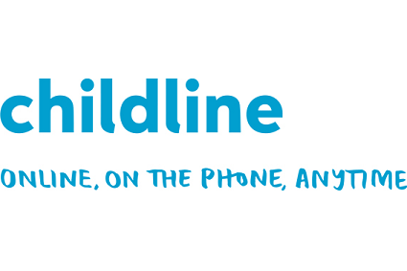
Getting help
meiccymru.org
childline.org.uk
0800 1111

