Slide 1


Infinite scroll
Primary lesson

Slide 2
Learning outcomes
Learners will be able to:
identify examples of infinite scroll
recognise other forms of persuasive design and their purpose
consider strategies for mitigating the effects of persuasive design on technology use
understand where to seek help or support if they are concerned about their or others’ use of technology and the internet.

Slide 3



Do you always have a choice in what you do or see online?

Slide 4

Has a decision ever been made for you about what to do next online?

Slide 5


Has this ever happened to you online?

Slide 6

You finish watching a video and another one plays automatically.

Slide 7

You receive a message from your friend asking you to play an online game.

Slide 8

You get a notification reminding you to log in to a game for a reward.

Slide 9

An app suggests a new artist to listen to based on the music you like.

Slide 10

Last week you browsed for games to buy with your birthday gift card. You get an email reminding you about what you put in your account basket.

Slide 11


You scroll down a webpage and new stories keep appearing.

Slide 12




Persuasive design
--- ------ ---- -- ?

Slide 13
Persuasive techniques
No saving | Changing mood | Infinite scroll
Time-limited offers | Notifications | Variable reward
Clickbait | Autoplay | Social obligation

Slide 14
Persuasive techniques – definitions
You never know what you might see next. The chance of seeing something exciting or interesting makes you want to keep consuming content. | Get it now or miss out on it forever! This is often used to encourage you to buy or do something quickly for fear of missing out. | Messages and vibrations on a device to tell you something ‘important’. Can also be red circles that appear on an app icon.
Automatically playing the next video or episode to keep you using an app or site for longer. | Loading new posts or stories as you scroll down the page so that you never reach the end – there is always something new to see! | Taking away regular save features so you have to play for longer – if you quit that two-hour mission, you’ll have to start it again.
Showing you things that the app or site knows you like – seeing these will encourage you to stay for more. | Showing someone when you have seen their message can put pressure on you to reply – otherwise they will think you’re ignoring them! | Stories with misleading titles designed to grab your attention and make you click on them – and they often turn out to be false!

Slide 15

The Children’s code
Companies must do lots of things to protect children’s privacy online.
This includes not using negative ‘nudge’ techniques – where companies may use large buttons or tick boxes to encourage children to make poor privacy choices.
But companies could use positive nudge techniques – like showing you a message to encourage you to take a break from playing a game.

Slide 16


Why could encouraging children to use technology longer be a problem?

Slide 17

Striking a balance
Look at your persuasive design cards again.
Can you think of any ways to help reduce their effects?
Turn them off in the device settings.
Put your device in a different room when not
in use.
Notifications

Slide 18

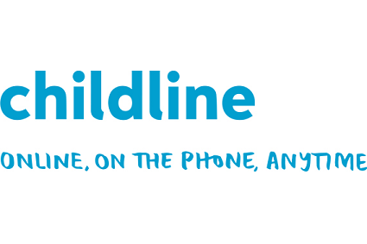
Getting help
meiccymru.org
childline.org.uk
0800 1111

