Slide 1
Digwyddiad ymgysylltu rhithiol Ar Drywydd Dysgu – 2 Rhagfyr 2020
Routes for Learning
virtual engagement event –
2 December 2020
Phil Martin, Jean Ware

Slide 2
Strwythur y sesiwn Structure of session
Ar Drywydd Dysgu: Dysgu proffesiynol
Routes for Learning: Professional learning
Adolygu
Ar Drywydd Dysgu:
Y cyd-destun
Nodweddion allweddol y deunyddiau diwygiedig
Datblygiadau yn y dyfodol – fideos, geirfa
Cwestiynau ac adborth
Routes for Learning
revision:
Context
Key features of the revised materials
Future developments – videos, glossary
Questions and feedback

Slide 3
Strwythur y sesiwn Structure of session
Ar Drywydd Dysgu: Dysgu proffesiynol
Routes for Learning: Professional learning
Deunyddiau dysgu proffesiynol:
Trosolwg
Sampl (modiwl thema 8)
Sut y gellid defnyddio'r deunyddiau dysgu proffesiynol?
Cwestiynau ac adborth
Professional learning materials:
Overview
Sample (theme 8 module)
How might the Professional learning materials be used?
Questions and feedback

Slide 4
Ar Drywydd Dysgu (fersiwn 2006) Routes for Learning (2006 version)
Ar Drywydd Dysgu: Dysgu proffesiynol
Routes for Learning: Professional learning
Cyfres o ddeunyddiau a ddatblygwyd yng Nghymru, yn benodol i asesu dysgwyr sydd ag anawsterau dysgu dwys a lluosog (ADDLl)
Fe’u cyhoeddwyd gyntaf yn 2006 gan Lywodraeth Cynulliad Cymru
A suite of materials developed in Wales specifically for the assessment of learners with profound and multiple learning difficulties (PMLD)
First published in 2006 by the Welsh Assembly Government

Slide 5
Ar Drywydd Dysgu (fersiwn 2006, parhad) Routes for Learning (2006 version contd.)
Ar Drywydd Dysgu: Dysgu proffesiynol
Routes for Learning: Professional learning
Fe’u mabwysiadwyd yn eang yn y DU, Iwerddon ac mewn mannau eraill (cyn belled ag Awstralia a Nigeria)
Addaswyd y deunyddiau a’u hailenwi’n ‘Quest for learning’ yng Ngogledd Iwerddon
Widely adopted in the UK, Ireland and elsewhere (as far afield as Australia and Nigeria)
The materials were adapted and retitled as ‘Quest for learning’ in Northern Ireland

Slide 6
Ar Drywydd Dysgu 2020 Routes for Learning 2020
Ar Drywydd Dysgu: Dysgu proffesiynol
Routes for Learning: Professional learning
Diweddaru’r deunyddiau gwreiddiol yn llwyr
Wedi’u datblygu’n benodol ar gyfer dysgwyr ag ADDLl
Ffrwyth gwaith amrywiaeth o ymarferwyr ac arbenigwyr academaidd
Yn adlewyrchu’r ymchwil diweddaraf yn y maes a chyd-destun y cwricwlwm newydd yng Nghymru
A full update of the original materials
Specifically developed for learners with PMLD
Undertaken by a range of practitioners and academic experts
Reflecting latest research in the field and the new curriculum context in Wales

Slide 7
Ar Drywydd Dysgu 2020 Routes for Learning 2020
Ar Drywydd Dysgu: Dysgu proffesiynol
Routes for Learning: Professional learning
Yn seiliedig ar ddatblygiad arferol, ond gan geisio ystyried effaith amhariadau corfforol a synhwyraidd
Yn cydnabod y gall dysgwyr ddilyn llwybrau gwahanol rhwng y cerrig milltir allweddol
Based on typical development, but tries to take into account the impact of physical and sensory impairments
Assumes that learners may take different routes between key milestones

Slide 8
Ar Drywydd Dysgu 2020 Routes for Learning 2020
Ar Drywydd Dysgu: Dysgu proffesiynol
Routes for Learning: Professional learning
Mae’r holl ddeunyddiau diwygiedig ar gael ar-lein yn:
https://hwb.gov.wales/cwricwlwm-i-gymru/ar-drywydd-dysgu
All of the updated materials can be accessed online at:
https://hwb.gov.wales/curriculum-for-wales/routes-for-learning

Slide 9
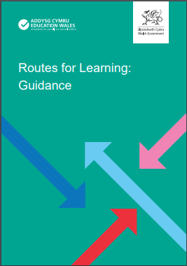
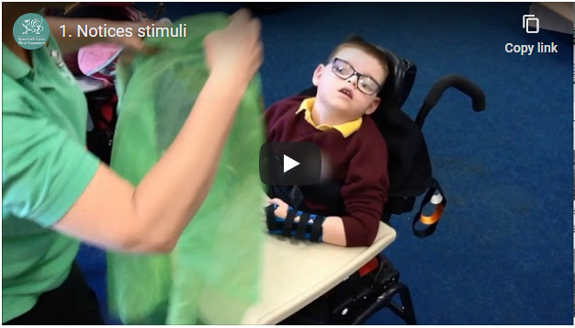
Prif elfennau’r gyfres Key elements of the suite
Ar Drywydd Dysgu: Dysgu proffesiynol
Routes for Learning: Professional learning
Canllawiau Guidance
Fideos enghreifftiol Exemplification videos

Slide 10
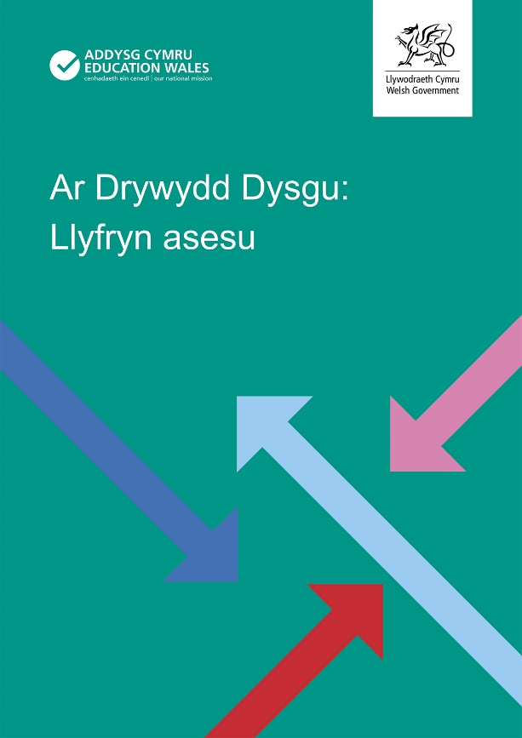
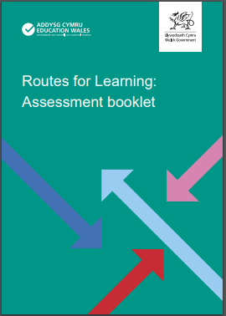
Prif elfennau’r gyfres Key elements of the suite
Ar Drywydd Dysgu: Dysgu proffesiynol
Routes for Learning: Professional learning
Llyfryn asesu Assessment Booklet

Slide 11
Y Map llwybrau Routemap
Ar Drywydd Dysgu: Dysgu proffesiynol
Routes for Learning: Professional learning

Slide 12
Fideos enghreifftiol Exemplification videos
Ar Drywydd Dysgu: Dysgu proffesiynol
Routes for Learning: Professional learning
https://youtu.be/bj6zgCKsXmA
https://youtu.be/JBsfuiTzhjQ

Slide 13
Ar Drywydd Dysgu: Canllawiau Routes for Learning: Guidance
Ar Drywydd Dysgu: Dysgu proffesiynol
Routes for Learning: Professional learning
Gan ganolbwyntio ar ddysgwyr sydd ag ADDLl, rhoddir sylw i:
asesu
damcaniaethau a safbwyntiau i lywio dulliau o addysgu
Focusing on learners with PMLD, this covers:
assessment
theories and perspectives that inform the ways in which learners are taught

Slide 14
Ar Drywydd Dysgu: Y Canllawiau Routes for Learning: Guidance
Ar Drywydd Dysgu: Dysgu proffesiynol
Routes for Learning: Professional learning
Cwricwlwm i Gymru
heriau cynhwysiant
dysgu a rhwystrau i ddysgu
cyfathrebu cynnar.
Curriculum in Wales
the challenges of inclusion
learning and barriers to learning
early communication.

Slide 15
Y Llyfryn asesu Assessment booklet
Ar Drywydd Dysgu: Dysgu proffesiynol
Routes for Learning: Professional learning
Mae’r Llyfryn asesu diwygiedig yn rhoi mwy o fanylion am bob un o focsys y Map llwybrau.
Gweithgareddau asesu/pethau i roi cynnig arnynt
Pethau i chwilio amdanynt
Strategaethau addysgu (i symud y dysgwr tuag at y cam hwn)
Gwahaniaethu rhwng y cam hwn a chamau eraill
Dwy enghraifft (naratif)
The updated Assessment booklet provides greater detail about each of the Routemap boxes.
Assessment activities/things to try
Things to look for
Teaching strategies (to move the learner towards this step)
Distinguishing this step from others
Two (narrative) examples

Slide 16
32. Tynnu sylw 32. Attracts attention
Ar Drywydd Dysgu: Dysgu proffesiynol
Routes for Learning: Professional learning
Gahaniaethu rhwng y cam hwn a chamau eraill
Yn absenoldeb rhyngweithio cymdeithasol, mae’r dysgwr yn cychwyn tynnu sylw
a bwrw bod partneriaid cyfathrebu sylwgar, ymatebol a chyfarwydd gerllaw, ac yn barod i ymateb.
Distinguishing this step from others
In the absence of an ongoing social interaction, the learner initiates a request for attention
provided that observant, responsive and familiar communication partners are nearby, and ready to respond.

Slide 17
39. Tynnu sylw person arall yn fwriadol er mwyn cyfathrebu angen 39. Deliberately attracts attention of another person in order to communicate need
Ar Drywydd Dysgu: Dysgu proffesiynol
Routes for Learning: Professional learning
Gwahaniaethu rhwng y cam hwn a chamau eraill
Yn absenoldeb rhyngweithio cymdeithasol, mae’r dysgwr yn cychwyn tynnu sylw.
Distinguishing this step from others
In the absence of an ongoing social interaction, the learner initiates a request for attention.

Slide 18
39. Parhad 39. Continued
Ar Drywydd Dysgu: Dysgu proffesiynol
Routes for Learning: Professional learning
Gellir dehongli’r cais yn glir, hyd yn oed gan bartneriaid cyfathrebu:
nad ydyn nhw’n nabod y dysgwr yn dda
nad ydyn nhw’n agos at y dysgwr ar y pryd
y mae eu sylw ar bethau eraill.
The request can be clearly interpreted even by communication partners:
who do not know the learner well
who are not near to the learner at the time
whose attention is elsewhere.

Slide 19
39. Parhad 39. Continued
Ar Drywydd Dysgu: Dysgu proffesiynol
Routes for Learning: Professional learning
Enghreifftiau
Pan fydd Ryan eisiau dod allan o’i gadair (neu i fyny o’r llawr), bydd e’n defnyddio llais uchel i dynnu sylw un o dîm y dosbarth, gan ddal ei freichiau i fyny wrth wneud hynny.
Examples
When Ryan wants to come out of his chair (or up from the floor), he will vocalise loudly to gain the attention of one of the class team, holding his arms up as he does so.

Slide 20
39. Parhad 39. Continued
Ar Drywydd Dysgu: Dysgu proffesiynol
Routes for Learning: Professional learning
Enghreifftiau
Pan fydd Melanie yn gweithio ar ei phen ei hun (e.e. yn defnyddio’r cyfrifiadur) ac eisiau rhywbeth, mae hi’n curo ochr (fetel) ei chadair olwyn nes bydd rhywun yn dod draw i siarad â hi
Examples
When Melanie is working on her own (e.g. using the computer) and wants something, she bangs the (metal) side of her wheelchair until someone comes over to speak to her.

Slide 21
Themâu’r Map llwybrau The Routemap themes
Ar Drywydd Dysgu: Dysgu proffesiynol
Routes for Learning: Professional learning
Mae’r Llyfryn asesu diwygiedig yn grwpio bocsys y Map llwybrau i 12 ‘thema’.
Mae Bocsys 32 a 39, felly, er enghraifft yn perthyn i ‘Thema 10: Gweithredu i dynnu sylw eraill’.
The updated Assessment booklet groups Routemap boxes into 12 ‘themes’.
So, for instance, Boxes 32 and 39 belong to ‘Theme 10: Acting to engage others’.

Slide 22
Themâu’r Map llwybrau The Routemap themes
Ar Drywydd Dysgu: Dysgu proffesiynol
Routes for Learning: Professional learning
Caiff y gwahanol themâu eu hesbonio yng nghyflwyniad y Llyfryn asesu (tudalennau 3–6) a cheir cyflwyniad penodol pellach i bob un.
The various themes are explained in the Assessment booklet’s introduction (pages 3–6) and each has its own introductory section.

Slide 23
Llinynnau’r Map llwybrau Routemap strands
Ar Drywydd Dysgu: Dysgu proffesiynol
Routes for Learning: Professional learning
Sgiliau cyfathrebu a rhyngweithio cymdeithasol
Datblygiad gwybyddol cynnar
Sut mae’r dysgwr yn rhyngweithio â’i amgylchedd
Communication and social interaction skills
Early cognitive development
Learners’ interaction with their environment

Slide 24
Themâu’r Map llwybrau Routemap themes
Ar Drywydd Dysgu: Dysgu proffesiynol
Routes for Learning: Professional learning
Cyfathrebu a rhyngweithio cymdeithasol | Communication and social interaction
Ymateb i bobl (2) | Responding to people (2)
Arwyddo hoffter o un peth dros rywbeth arall (4) | Signalling preferences (4)
Bod yn gymdeithasol (7) | Being sociable (7)
Gweithredu i dynnu sylw eraill (10) | Acting to engage others (10)
Dewis opsiynau (12) | Choosing options (12)

Slide 25
Themâu’r Map llwybrau Routemap themes
Ar Drywydd Dysgu: Dysgu proffesiynol
Routes for Learning: Professional learning
Datblygiad gwybyddol | Cognitive development
Ymateb i batrwm a gyflwynir fwy nag unwaith (3) | Responding to pattern in repetition (3)
Gwybod lle mae gwrthrych (5) | Keeping track of objects (5)
Newid ffocws (8) | Changing focus (8)
Cysylltu gweithred â chanlyniad (9) | Connecting actions with outcomes (9)

Slide 26
Themâu’r Map llwybrau Routemap themes
Ar Drywydd Dysgu: Dysgu proffesiynol
Routes for Learning: Professional learning
Rhyngweithio â’r amgylchedd | Environmental interaction
Ymateb i stimwli (1) | Responding to stimuli (1)
Gweithredu o fewn amgylchedd y dysgwr | Acting on the physical environment (6)
Datrys problemau (11) | Solving problems (11)

Slide 27
Deunyddiau dysgu proffesiynol Professional learning materials
Ar Drywydd Dysgu: Dysgu proffesiynol
Routes for Learning: Professional learning
Adborth
Awgrymiadau
Cwestiynau
Feedback
Suggestions
Questions

