Slide 1
National exploration of pedagogy
Archwiliad cenedlaethol o addysgeg
To 2022…. and beyond!
Hyd at 2022…. a thu hwnt!

Slide 2
Focus for today / Ffocws heddiw
Exploring Pedagogy – and why is it important?
Outline the big picture for our national exploration
Talk Pedagogy
Archwilio Addysgeg - a pham ei fod yn bwysig?
Amlinellu’r darlun mawr ar gyfer ein harchwiliad cenedlaethol o addysgeg
Trafod Addysgeg
Opportunity to listen, think and discuss Cyfle i wrando, meddwl a thrafod

Slide 3
Why do you think it is important to ‘Talk Pedagogy’?
Pam ydych chi'n meddwl ei bod hi'n bwysig ‘Trafod Addysgeg’?

Slide 4
How will we know if we have been successful?
Sut fyddwn yn gwybod a ydym wedi bod yn llwyddiannus?
Cynnydd?
Progression?
Profiadau Dysgu?
Learning experiences?
Mewn / In 10 mlynedd / years
Fel sefydliad sy’n dysgu?
As a learning organisation?
Dysgu ac addysgu?
Teaching and Learning?
Y diwrnod ysgol?
The school day?
Amgylched ddysgu?
Learning environment?
(physical and emotional)

Slide 5
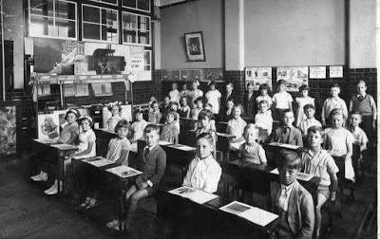
Exploring pedagogy / Archwilio addysgeg
What is in the teacher’s mind?
What was the thinking?
What type of interactions are planned?
What type of relationships are being developed?
Beth sydd ym meddwl yr athro?
Beth oedd y meddwl y tu ôl i hynny?
Pa fath o ryngweithio sy’n cael eu cynllunio?
Pa fath o berthnasoedd sy'n cael eu datblygu?

Slide 6
Exploring pedagogy / Archwilio addysgeg
What is in the teacher’s mind?
What was the thinking?
What type of interactions are planned?
What type of relationships are being developed?
Beth sydd ym meddwl yr athro?
Beth oedd y meddwl y tu ôl i hynny?
Pa fath o ryngweithio sy’n cael eu cynllunio?
Pa fath o berthnasoedd sy'n cael eu datblygu?

Slide 7
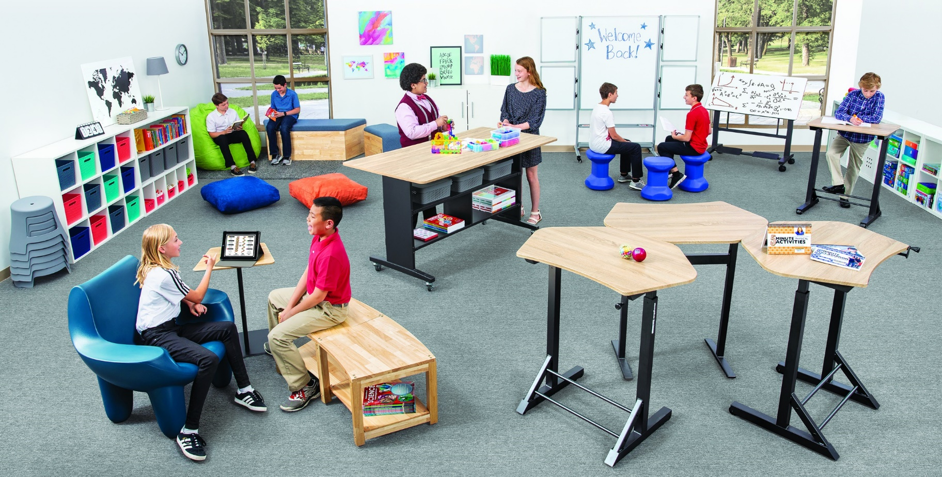
Exploring pedagogy / Archwilio addysgeg
What is in the teacher’s mind?
What was the thinking?
What type of interactions are planned?
What type of relationships are being developed?
Beth sydd ym meddwl yr athro?
Beth oedd y meddwl?
Ar gyfer pa fath o ryngweithio sydd ar y gweill?
Pa fath o berthnasoedd sy'n cael eu datblygu?

Slide 8
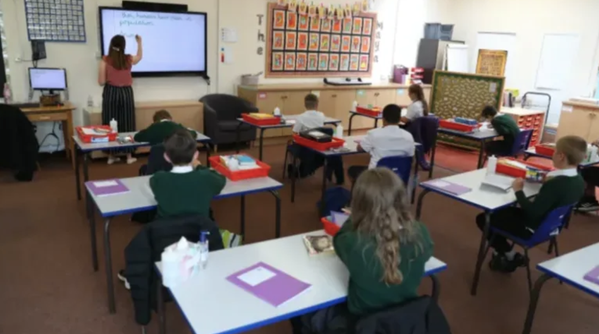
Exploring pedagogy / Archwilio addysgeg
What is in the teacher’s mind?
What was the thinking?
What type of interactions are planned?
What type of relationships are being developed?
Beth sydd ym meddwl yr athro?
Beth oedd y meddwl?
Ar gyfer pa fath o ryngweithio sydd ar y gweill?
Pa fath o berthnasoedd sy'n cael eu datblygu?

Slide 9
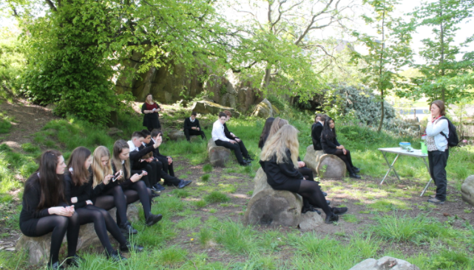
Exploring pedagogy / Archwilio addysgeg
What is in the teacher’s mind?
What was the thinking?
What type of interactions are planned?
What type of relationships are being developed?
Beth sydd ym meddwl yr athro?
Beth oedd y meddwl?
Ar gyfer pa fath o ryngweithio sydd ar y gweill?
Pa fath o berthnasoedd sy'n cael eu datblygu?

Slide 10
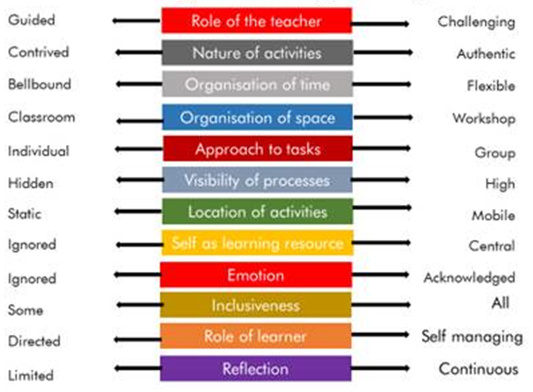
Exploring pedagogy / Archwilio addysgeg
Excellent, effective and innovative practice across the system.
What do we do?
Why do we do it?
From a four purposes perspective – is it transferable?
Ymarfer gwych, effeithiol ac arloesol ar draws y system.
Beth ydyn ni’n gwneud?
Pam ein bod ni’n gwneud hynny?
Ydy’n drosglwyddadwy – o berspectif y Pedwar Diben?
Diagram taken from:
Lead Creative Schools, Arts Council of Wales

Slide 11
Exploring pedagogy / Archwilio addysgeg
- Professional conversations to share the professional knowledge and expertise that is in our schools
Sharing the innovative thinking that is taking place
Deepening our understanding
Co-constructing our understanding of pedagogy within the context of the four purposes
Transforming education in Wales together
- Sgyrsiau proffesiynol i rannu'r wybodaeth a'r arbenigedd broffesiynol sydd yn ein hysgolion
- Rhannu'r meddwl arloesol sy'n digwydd
- Dyfnhau ein dealltwriaeth
- Cyd-lunio ein dealltwriaeth o addysgeg yng nghyd-destun y pedwar diben
- Trawsnewid addysg yng Nghymru gyda'n gilydd

Slide 12
Exploring pedagogy / Archwilio addysgeg
One school’s perspective – Gilwern Primary School
Enquiry Question:
“How do primary practitioners interpret the term 'pedagogy' in the context of the new curriculum for Wales?'
What does pedagogy mean to me ?
Persbectif un ysgol – Ysgol Gynradd Gilwern
Cwestiwn Ymholi:
“Sut mae ymarferwyr cynradd yn dehongli'r term 'addysgeg' yng nghyd-destun cwricwlwm newydd i Gymru? '
Beth mae addysgeg yn ei olygu i mi?

Slide 13
Strategic rationale
Dyfodol Llwyddiannus / Successful Futures (2015)
Cenhadaeth ein cenedl / Our national mission (2017)
Cenhadaeth ein cenedl / Our national mission – Diweddariad / Update (2020)
Safonau Proffesiynol ar gyfer Addysgu ac Arweinyddiaeth / Professional Standards for Teaching and Leadership
Adolygiad o’r Cyfnod Sylfaen / Review of the Foundation Phase (2015)
OECD
Estyn
‘considering how teaching may need to change to reflect the aspirations of the Curriculum for Wales, aligning pedagogy closely to developing the four purposes’ ESTYN 2020

Slide 14
Pedagogy / Addysgeg
Link to Pedagogy page on Hwb
Dolen i’r dudalen addysgeg ar Hwb

Slide 15
Exploring Pedagogy / Archwilio addysgeg
National exploration of pedagogy
Purpose-Driven Classroom
'Why it works?' Making sense through collaborative enquiry
Common language and understanding of learning
Talking and trialling?
Professional Enquiry -is it working and why?
'What works?' -talking and sharing
Research and Evaluation
Exploring current thinking and practice
Pedagogy and realising the new curriculum
Short – Medium Term
Medium – Long Term
Apply
Describe
Synthesise
Creativity
Understand
Evaluation
Analyse
Metacognitive

Slide 16
Key processes / Prosesau allweddol
Professional Engagement and Exploration
Ymgysylltu ac archwilio proffesiynol
Supporting leaders through collaboration - the strategic leadership of pedagogy
Cefnogi arweinwyr trwy gyd-weithio – arweinyddiaeth strategol addysgeg
Pedagogy for professional learning - creating and facilitating experiences
Addysgeg ar gyfer dysgu proffesiynol – creu a hwyluso profiadau

Slide 17
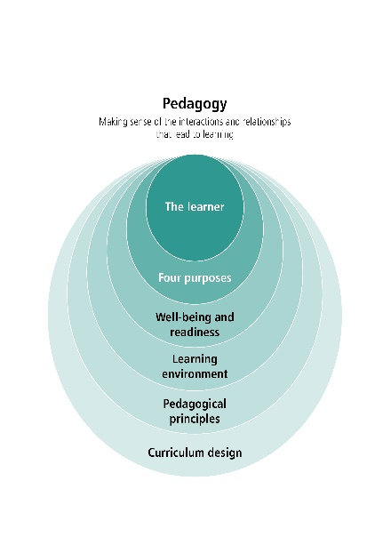
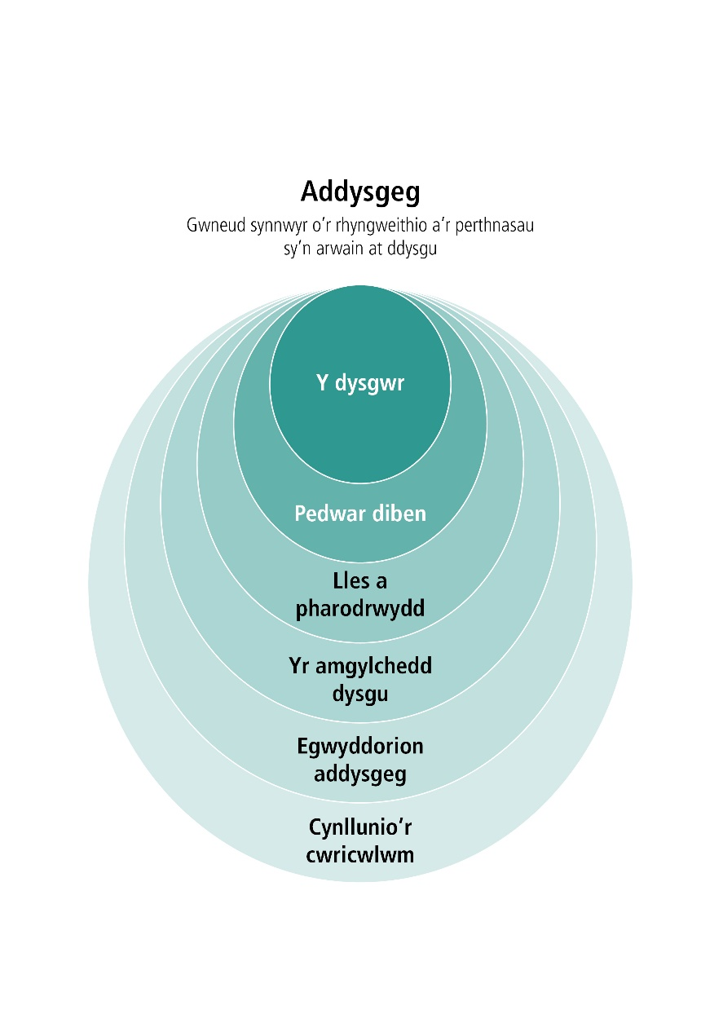
Talk Pedagogy, Think Learning /
Trafod Addysgeg, Meddwl ym Ddysgu
An on-line community supporting the exploration of pedagogy
Sharing thinking and reflection
Deepening understanding and supporting innovation through collaboration
Cymuned ar-lein sy'n cefnogi archwilio addysgeg
Rhannu meddwl a myfyrio
Dyfnhau dealltwriaeth a chefnogi arloesedd trwy gydweithredu
Link to Talk Pedagogy

Slide 18
Impact of COVID19 / Effaith COVID19
Rapid change
Recognise the enormous efforts of staff
Sharing experiences of ‘what works’, and perhaps ‘what has not worked’
Springboard to influence our work moving forward
Newid cyflym
Cydnabod ymdrechion enfawr staff
Rhannu profiadau o ‘beth sy’n gweithio’, ac efallai ‘beth sydd heb weithio’
Sbardun i ddylanwadu ar ein gwaith wrth symud ymlaen

Slide 19
Talk Pedagogy – planned activity
Trafod Addysgeg – gweithgaredd wedi’i gynllunio
Arweinyddiaeth strategol addysgeg
Strategic Leadership of Pedagogy
Recruit, Recover, Raise Standards
Recrwtio, adfer a chodi safonau
ADY / Ar drywydd dysgu
ALN / RfL
Pedagogy in the COVID classroom
Addysgeg yn y dosbarth COVID
Cynnydd, asesu ac adborth
Progression, assessment and feedback
All Age Schools Forum
Fforwm ysgolion pob oed
Egwyddorion addysgeg
Pedagogical Principles
Leading Collaborative Learning Project
Prosiect Arwain Dysgu Cydweithredol
Addysgeg a Llafaredd
Pedagogy and Oracy
Remote Asynchronous Learning Design
Dylunio dysgu o bell anghydamserol
Learning from the Foundation Phase
Dysgu wrth y Cyfnod Sylfaen
Creativity and Pedagogy
Creadigrwydd ac Addysgeg

Slide 20
Outputs / Allbynnau
Conversation / Trafodaeth
Collaboration / Cydweithio
Resources / Adnoddau
Enquiry reports / Adroddiadau ymholi
Research papers / Papurau ymchwil
Within Talk Pedagogy / O fewn Trafod Addysgeg
Within Talk Pedagogy / O fewn Trafod Addysgeg
Accessible, PL friendly / Hygyrch ac addas ar gyfer dysgu proffesiynol
Available on Hwb – Pedagogy , PLJ / Ar gael ar Hwb- Addysgeg,TDP
Shared within Talk Pedagogy / Rhannu o fewn Trafod Addysgeg
Available on Hwb – Pedagogy , PLJ / Ar gael ar Hwb – Addysgeg,TDP
Available on Hwb – Pedagogy , Professional Learning journey / Ar gael ar Hwb – Addysgeg, Taith Dysgu Proffesiynol
Shared in EBSCO / Rhannu ar EBSCO
Across networks / Ar draws rhwydweithiau
Across networks / Ar draws rhwydweithiau

Slide 21
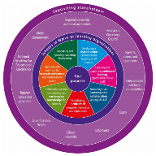
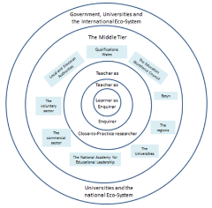
Rhyng-berthynas / Inter-relationships
Cwricwlwm i Gymru / Curriculum
for Wales
Archwilio Addysgeg / National Exploration of Pedagogy
COVID19
Parhad Dysgu / Continuity of Learning

Slide 22
Next Steps
Camau nesaf
Short Term – December 2020 to March 2021
Develop Talk Pedagogy activity areas – primary focus on the current situation
Invite further formal and informal engagement in Talk Pedagogy in relation to the new curriculum
Start conversations in Talk Pedagogy
Medium Term – March to December 2021
Develop artefacts / assets / resources as appropriate and share on Hwb
Develop further Talk Pedagogy activity areas in relation to the new curriculum as identified
Operationalise Steering Group and roles of other linked groups.
Develop Pedagogy Network Hub schools.
Develop collaborative enquiry
Capture ‘language of learning’
Plan for higher level research and evaluation
Long Term – January 2021 to August 2023
Develop the cycle of conversation, collaboration, enquiry and research to support and develop our understanding of pedagogy within the context of the new curriculum
Tymor Byr – Rhagfyr 2020 - Mawrth 2021
Datblygu Trafod Addysgeg – ffocws are y sefyllfa bresenol
Annog ymgysylltu ffurfiol ac anffurfiol pellach yn Trafod Addysgeg mewn perthynas â’r cwricwlwm newydd
Cychwyn sgyrsiau yn Trafod Addysgeg
Tymor Canolig – Mawrth - Rhagfyr 2021
Datblygu adnoddau yn ôl yr angen i’w rhannu ar Hwb
Parhau i ddatblygu Trafod Addysgeg mewn perthynas â’r cwricwlwm newydd
Gweithredu’r Grŵp Llywio a rolau grwpiau perthnasol eraill.
Datblygu ysgolion rhwydwaith addysgeg arweiniol.
Datblygu ymholi cydweithredol
Cofnodi ‘iaith dysgu’
Cynllun ar gyfer ymchwil lefel uwch a gwerthuso
Tymor Hir – Ionawr 2021 - Awst 2023
Datblygu cylch o drafodaethau, cydweithio, ymholi ac ymchwil i gefnogi a dyfnhau ein dealltwriaeth o addysgeg yng nghyd-destun y cwricwlwm newydd.

Slide 23
Policy Insights (Spring Term) / Mewnwelediadau Polisi (Tymor y Gwanwyn)
Professional Enquiry | Ymholi Proffesiynol
Digital Professional Learning | Dysgu Proffesiynol Digidol
National Evaluation & Improvement Resource (NEIR) | Adnodd Gwerthuso a Gwella Cenedlaethol
Pedagogy/Assessment | Addysgeg/Asesu
Schools as Learning Organisations 2 | Ysgolion fel Sefydliadau sy’n Dysgu 2
Strategic Leadership of Pedagogy | Arweinyddiaeth Strategol Addysgeg
*further details to follow in Dysg and via the Hwb Policy Insights Page:
*manylion pellach i ddilyn trwy Dysg a’r tudalen Mewnwelediadau Polisi ar Hwb:
https://hwb.gov.wales/professional-development/policy-insight-events/
https://hwb.gov.wales/datblygiad-proffesiynol/digwyddiadau-mewnwelediad-polisi
Opportunity to listen, think and discuss Cyfle i wrando, meddwl a thrafod

