Slide 1
Beth yw’r Daith Ddysgu Proffesiynol (PLJ)?
What is the Professional Learning Journey (PLJ)?

Slide 2
Beth yw’r PLJ?
Model llinol sy’n cyfuno SLO a’r NAPL, wedi’i gefnogi gan adnoddau astudiaeth achos, er mwyn darparu llwybr i gefnogi ysgolion gyda’u paratoadau am y cwricwlwm newydd.
Pwrpas
Cyfuno gwahanol fodelau a dulliau gweithredu
Cefnogi ysgolion i baratoi ar gyfer y cwricwlwm newydd
Darparu model cenedlaethol integredig, wedi'i gefnogi gan adnoddau cenedlaethol a rhaglen ddysgu broffesiynol ranbarthol
Gwneud y canllawiau'n fyw trwy enghreifftiau astudiaeth achos ysgol
Mae astudiaethau achos ysgolion yn canolbwyntio ar pam a sut yr ymgymerwyd â'r datblygiadau.
Cefnogi ysgolion gydag adnoddau ar gyfer diwrnodau dysgu proffesiynol cenedlaethol ychwanegol yn 2020-22.
Purpose
Combines different models and approaches
Supports schools with preparation for the new curriculum
Provides an integrated national model, supported by national resources and regional professional learning programme
Makes the guidance live via school case study examples
School case studies focus on why and how the developments were undertaken.
Supports schools with resources for additional national professional learning days in 2020-22.
What is the PLJ?
A linear model combining SLO and NAPL, supported by case study resources, to provide a route map for schools to help them prepare for the new curriculum.

Slide 3
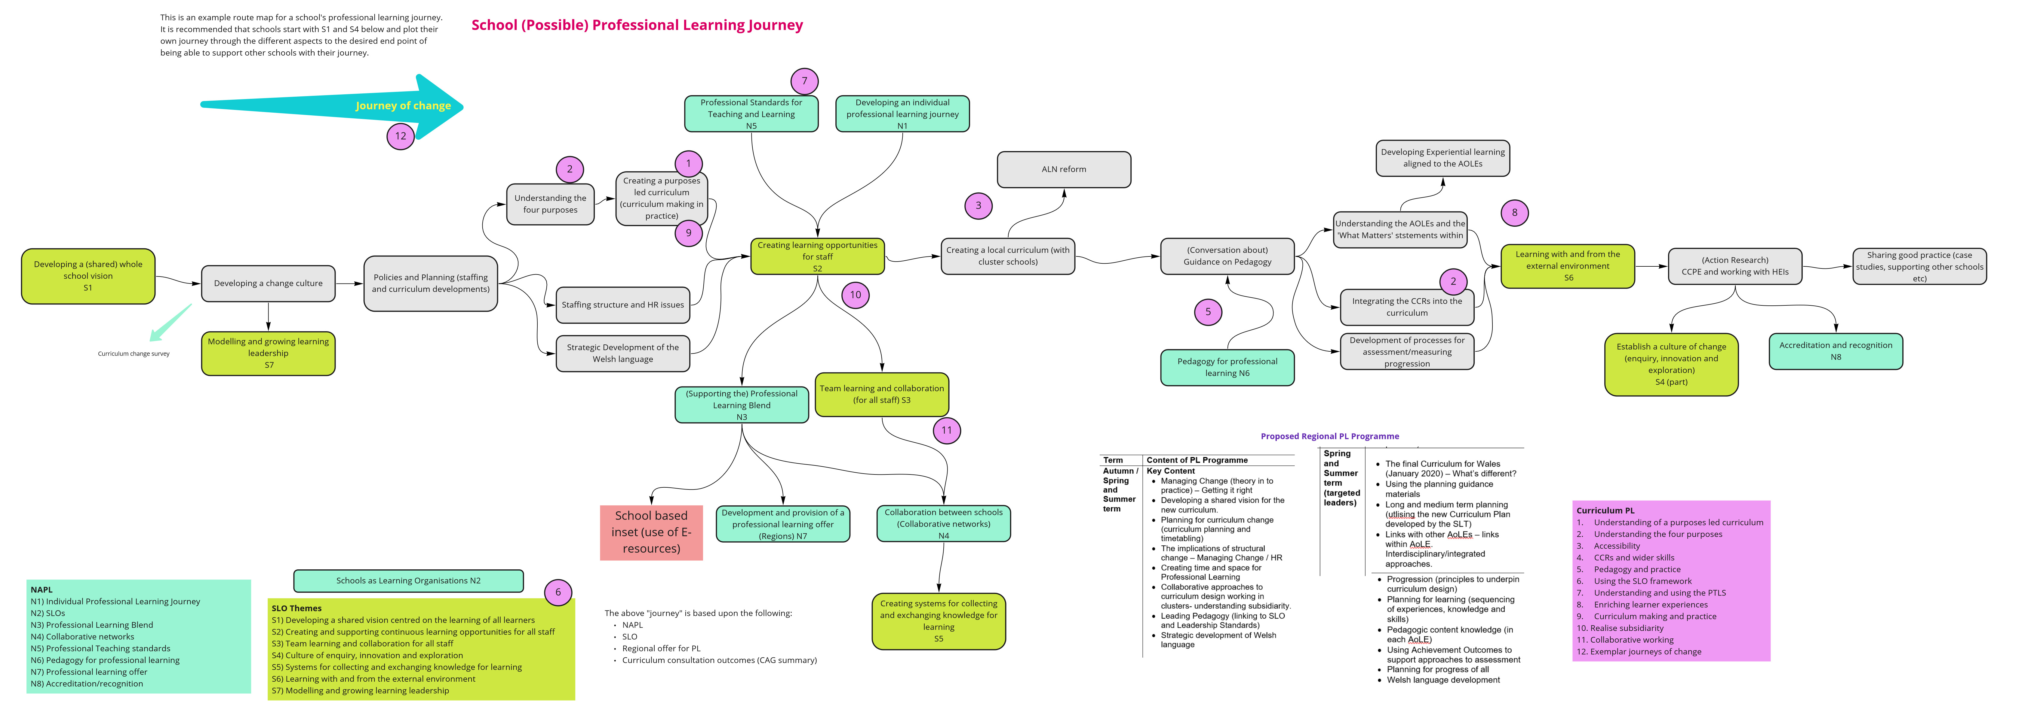
Datblygiadau cynnar i gynllun y PLJ
Early PLJ Design

Slide 4
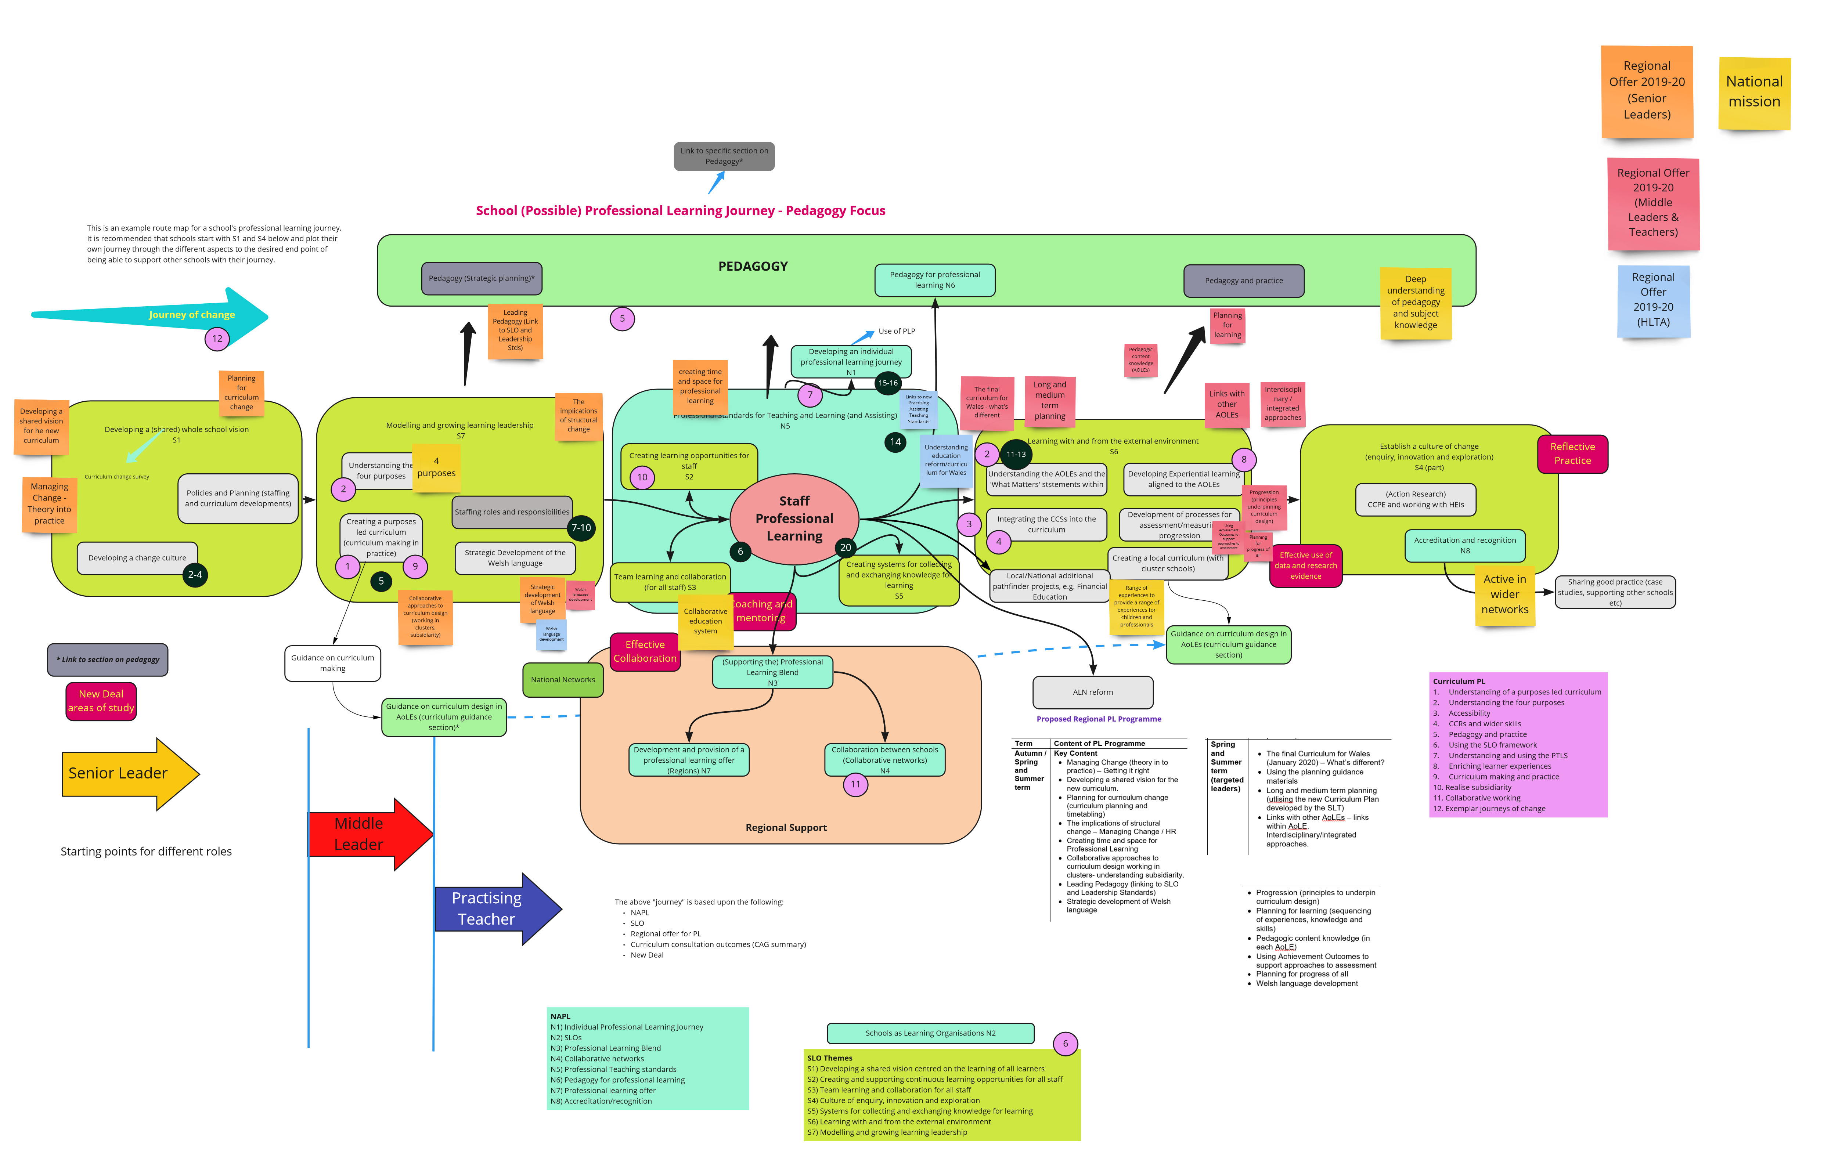
Model cymhleth – cyfuno’r holl fodelau DP, addysgeg, cynnig rhanbarthol a phrosiectau e-adnoddau.
Complex model – combining all PL models, pedagogy, regional offer and e-resources projects
Vision
Managing change
Innovation
Professional Learning
Learning from the wider system
Enquiry and exploration
Regional support programme

Slide 5
Y Daith Ddysgu Proffesiynol – Trosolwg /
The Professional Learning Journey - Overview
Notes:
Show the website (live)
Show the interactive graphic and navigation to playlist resources
Show some playlist resources (KHS + Romilly)
Explain how the resources can be used and the advantages of playlists
Show the Sway which will feature on front page + brief narrative (get it live by 17/11).

Slide 6
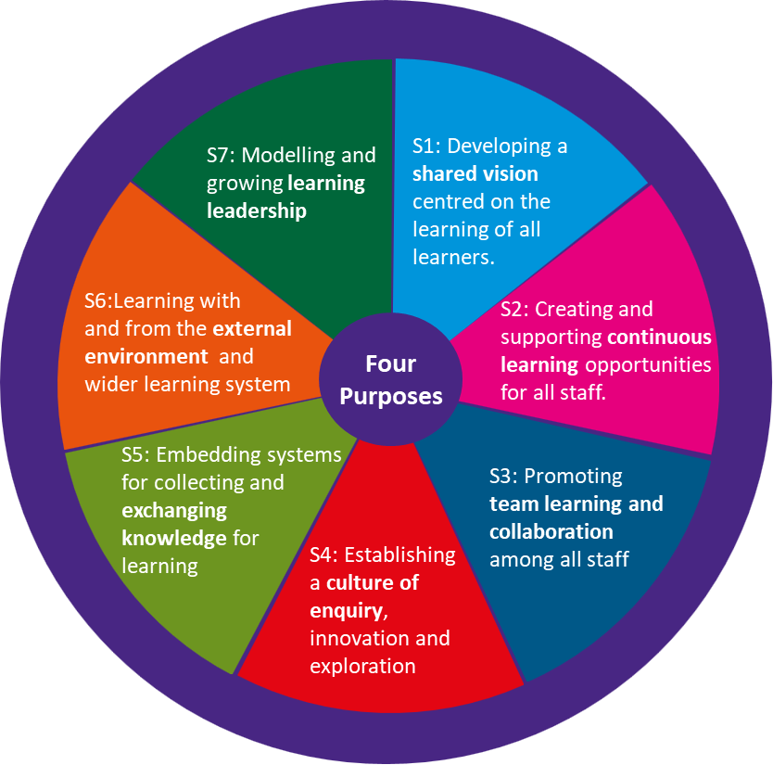
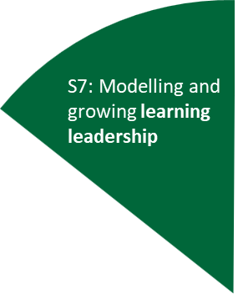
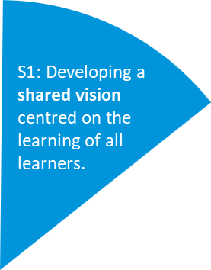
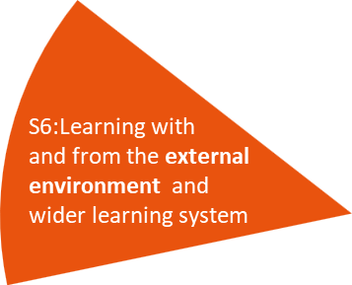
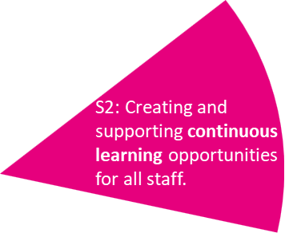
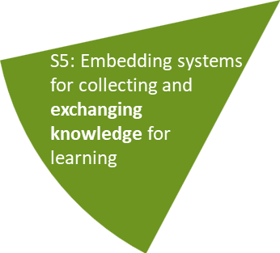
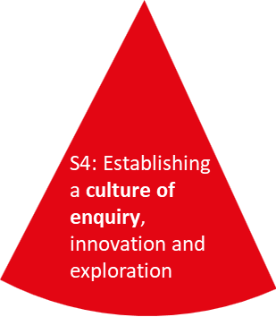
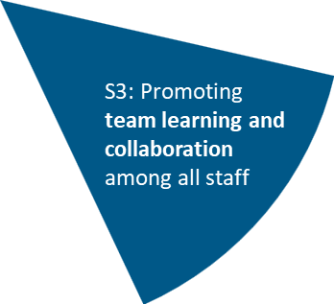
Cysylltu Ysgolion fel Sefydliadau sy’n Dysgu i’r Daith Ddysgu Proffesiynol
Linking Schools as Learning Organisations to the Professional Learning Journey

Slide 7
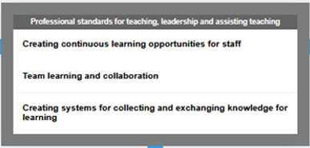
Cysylltu’r Daith Ddysgu Proffesiynol i’r model Ysgolion fel Sefydliadau sy’n Dysgu
Linking the Professional Learning Journey to Schools as Learning Organisations

Slide 8
Cysylltiadau i fodelau/dulliau/prosiectau eraill
Links to other models/approaches/projects
The PLJ already incorporates the following
Schools as learning organisations
The national approach to professional learning
The national regional support programme
The new curriculum for Wales
Work is underway to further align the PLJ to the following:
National Pedagogy Project
The National Evaluation and Improvement Resource
The National Professional Enquiry Project
Mae’r PLJ yn cynnwys yn ymgorffori’r canlynol
Ysgolion fel sefydliadau sy’n dysgu
Y dull cenedlaethol ar gyfer dysgu proffesiynol
Y rhaglen gymorth ranbarthol genedlaethol
Y cwricwlwm newydd i Gymru
Mae gwaith ar y gweill i alinio’r PLJ ymhellach gyda’r
Prosiect Addysgeg Cenedlaethol
Yr Adnodd Gwerthuso a Gwella Cenedlaethol
Y Prosiect Ymholi Proffesiynol Cenedlaethol

Slide 9
Y Daith Ddysgu Broffesiynol (PLJ-1)
The Professional Learning Journey (PLJ-1)
Cyhoeddwyd y gwefan a’r adnoddau ar ddechrau Mai 2020
Ar gael mewn ardal gyhoeddus ar Hwb
Dolen (Gymraeg)
19 rhestr chwarae, astudiaethau achos gan ysgolion
Cyswllt i brosiectau eraill: Talk Pedagogy, SLO, NEIR
Website and resources published at the beginning of May 2020
Available in a public area on Hwb
Link (English)
19 case study playlists from schools
Links to other projects: Talk Pedagogy, SLO, NEIR
Notes:
Explain the progress to date.

Slide 10
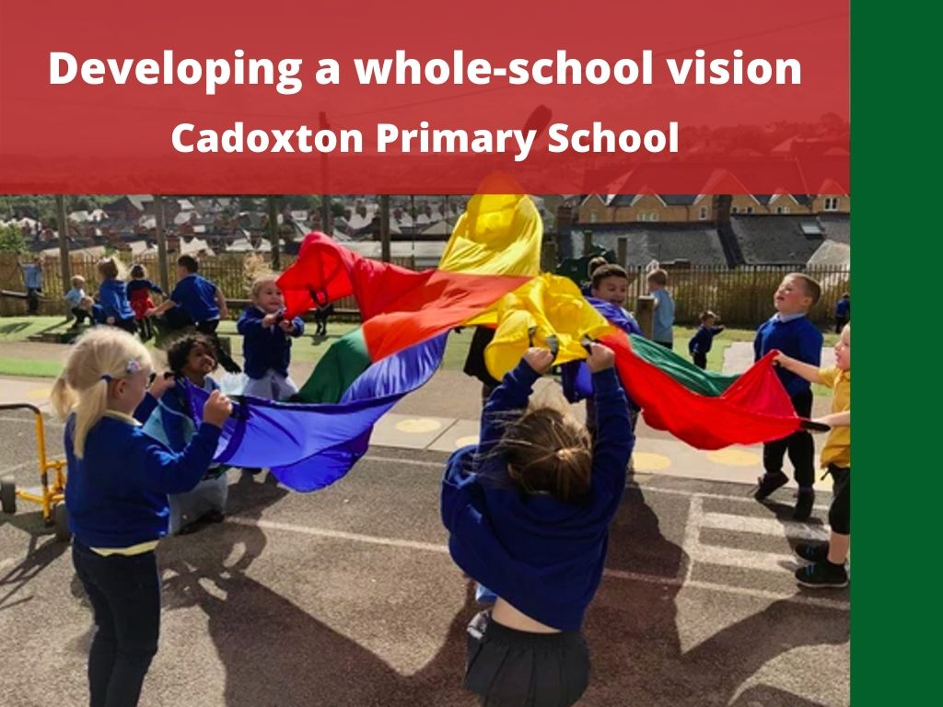
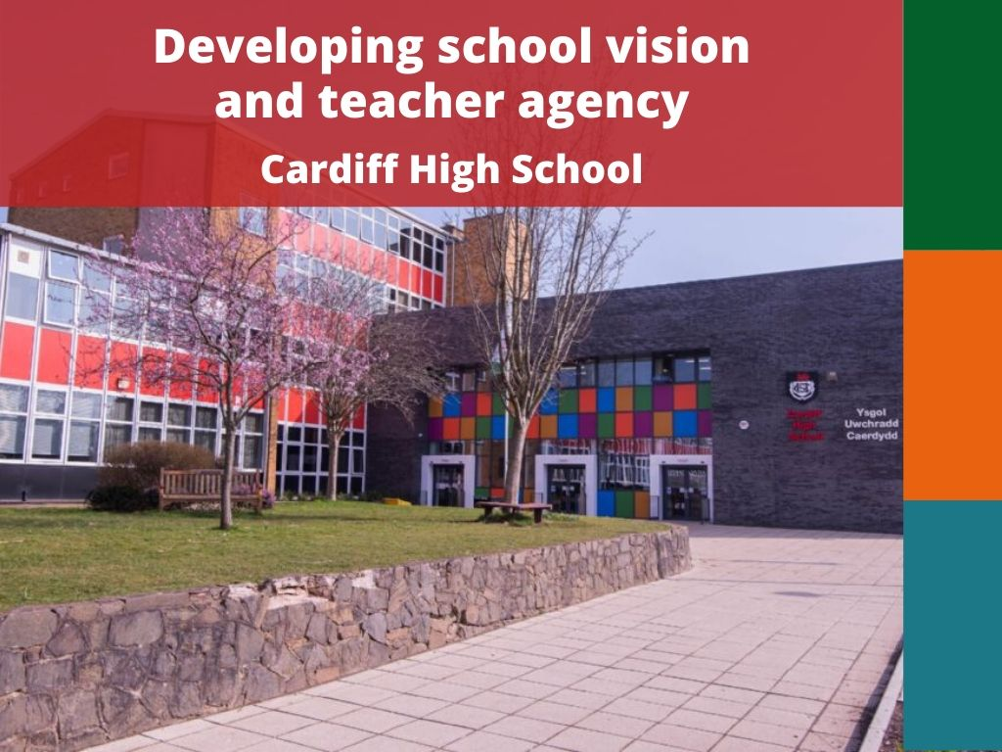
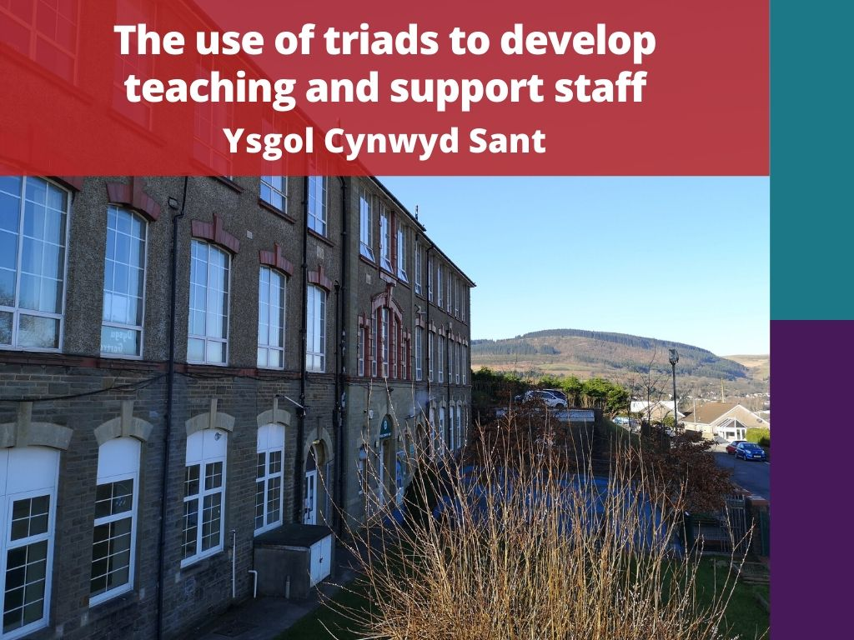
Rhestrau Chwarae ar Hwb…
Hwb Playlists…
Cynulleidfa ar gyfer yr adnodd/Audience for the resource
Uwch arweinwyr / Senior Leaders
Athrawon / Teachers
Arweinwyr canol / Middle Leaders
Staff cymorth / Support staff
Notes:
Explain the coding for audiences.

Slide 11
Datblygu gweledigaeth ysgol gyfan a rennir
Developing a shared whole school vision

Slide 12
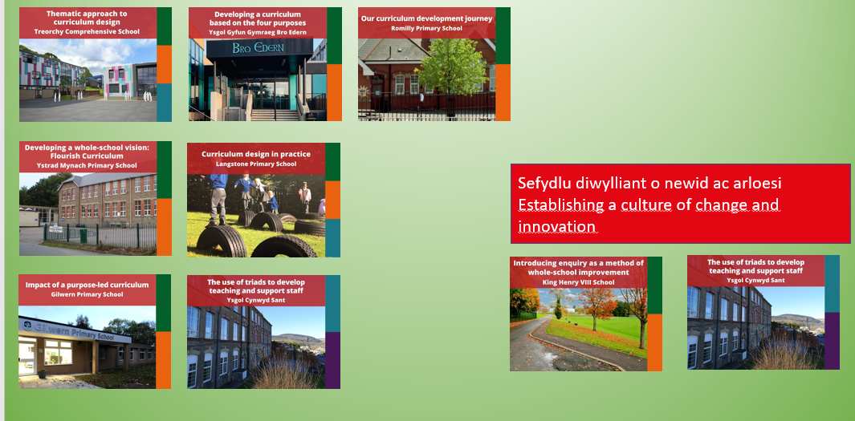
Modelu arweinyddiaeth dysgu
Modelling learning leadership

Slide 13
Creu cyfleoedd dysgu parhaus i staff
Creating continuous learning opportunities for staff
Dysgu mewn tîm a chydweithio
Team learning and collaboration
Creu systemau ar cyfer casglu a chyfnewid gwybodaeth at ddibenion dysgu
Creating systems for collecting and exchanging knowledge for learning

Slide 14
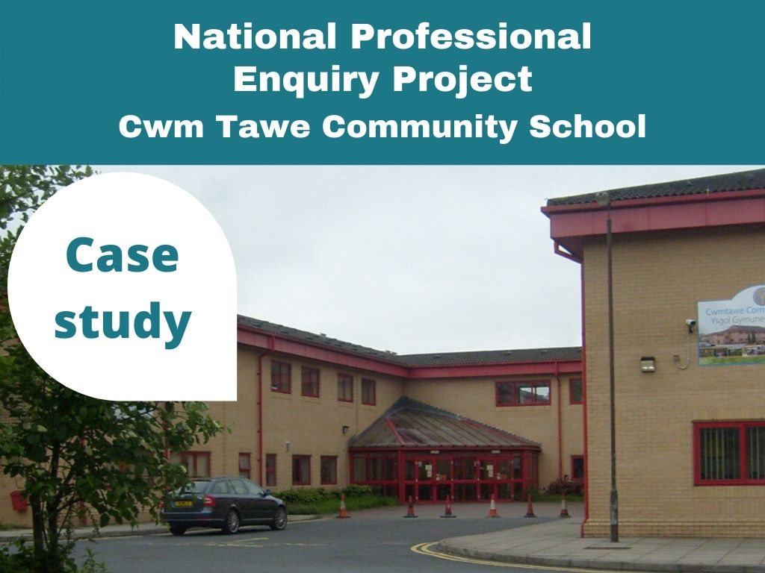
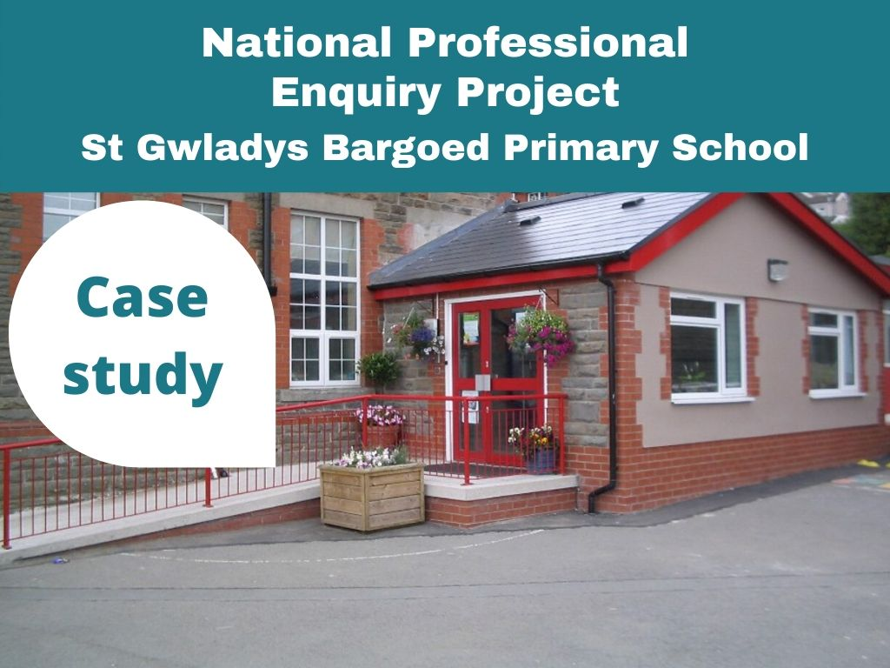
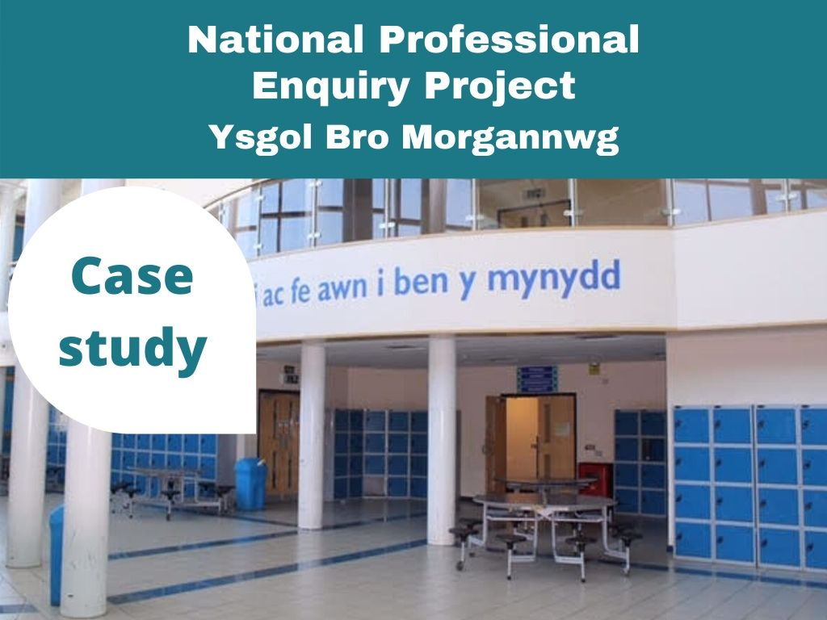
Dysgu trwy’r system ddysgu ehangach
Learning through the wider learning system
Sefydlu diwylliant o ymholi ac archwilio
Establishing a culture of enquiry and exploration
MFL Case study (Roath Park Primary)
Not yet published
PYPC/NPEP
Dolen/link

Slide 15
Diben yr adnoddau
Cipio arfer dda mewn ysgolion
Alinio i baratoadau am y cwricwlwm newydd
Yn cynnwys gwybodaeth: Pam?, Beth?, Sut? a Beth felly?
Cludadwy i fod o ddefnydd gan ysgolion eraill
Wedi cyflwyno mewn modd syml a hygyrch
Yn cynnwys mewnbwn gan randdeiliaid amrywiol
Yn cynnwys adnoddau/ffeiliau a ddefnyddiwyd gan yr ysgol
Purpose of the resources
Capture good practice in schools
Aligns to the preparation for the new curriculum
Includes information on: Why?, What? , How? and So what?
Portable to be of use by other schools
Presented in a simple and accessible manner
Includes input from different stakeholders
Includes files/resources used by the school
Rhannu profiadau gan ysgolion oedd ynghlwm llynedd / Sharing experiences from schools involved last year
Notes:
Explain about the Distribution of resources and deliberate attention to the LH side of the PLJ to support schools with vision etc.
Talk about the National regional support programme and how this is restarting with programmes around managing change and creating a vision.

Slide 16
Gwedd 2 y Daith Ddysgu Proffesiynol
Phase 2 of the Professional Learning Journey
Mor belled...
22 ysgol wedi’u comisiynu i greu 26 rhestr chwarae
So far...
22 schools have been commissioned to produce 26 playlists
Dyddiad cyhoeddi’r rhestrau chwarae newydd: gwedd 1 a 2
Gwedd 1 / Phase 1: Ebrill 2021
Gwedd 2/ Phase 2: Gorffennaf 2021
Playlist publication dates: tranche 1 and 2
Tranche 1: April 2021
Tranche 2: July 2021
Notes:
Explain about the Distribution of resources and deliberate attention to the LH side of the PLJ to support schools with vision etc.
Talk about the National regional support programme and how this is restarting with programmes around managing change and creating a vision.

Slide 17
Rhai o'r adnoddau rhestr chwarae sy'n cael eu datblygu:
Defnyddio gwyddoniaeth wybyddol i ddatblygu'r cwricwlwm
Datblygu strwythurau staffio a datblygu'r cwricwlwm (Iechyd a Lles)
Ymagweddau pobl-ganolog tuag at DPP
Cyfrifoldeb a rennir am ddylunio'r cwricwlwm
Datblygu staff fel ymholwyr
Datblygu dealltwriaeth staff a dysgwyr o'r pedwar diben
Datblygu cwricwlwm lleol o amgylch y pedwar diben
Datblygu arweinwyr a rheolaeth ‘fain’
Datblygu'r cwricwlwm trwy nodau datblygu cynaliadwy
Some of the playlist resources being developed:
Using cognitive science to develop the curriculum
Developing staffing structures and developing the curriculum (Health & Well-being)
People-centric approaches to CPD
Shared responsibility for curriculum design
Developing staff as enquirers
Developing staff and learners’ understanding of the four purposes
Developing a local curriculum around the four purposes
Developing leaders and lean management
Developing the curriculum through sustainable development goals

Slide 18
Oes diddordeb gennych mewn cymryd rhan?
Are you interested in taking part?
Ffurflen ar-lein hon/ Complete this online form
Mae angen cwblhau’r ffurflen erbyn Tachwedd 20fed /
The forms needs to be completed by November 20th

Slide 19
Datblygu adnoddau ar gyfer y PLJ
Developing resources for the PLJ
Os cymerwch ran, byddwch yn
Nodi maes datblygu arfer dda yn eich ysgol
Alinio'r ardal hon â chydran (nau) y PLJ
Cynhyrchu bwrdd stori a rhestr chwarae
Os cymerwch ran, fe wnawn ni
Ddarparu sesiynau cymorth 1: 1
Ddarparu gweithdai datblygu a chyfleoedd rhwydweithio
Cyhoeddu astudiaeth achos eich ysgol ar Hwb
If you take part, you will
Identify an area of good practice development in your school
Align this area to the component(s) of the PLJ
Produce a playlist storyboard and playlist
If you take part, we will
Provide 1:1 support sessions
Provide development workshops and networking opportunities
Publish your school’s case study on Hwb

Slide 20
Mewnwelediad polisi nesaf:
Ysgolion fel Sefydliadau sy’n Dysgu
Next policy insight:
Schools as Learning Organisations
Arweinir gan / Led by
Ann Bradshaw
Llywodraeth Cymru / Welsh Government
Tachwedd 26ain, 2020 2:00-3:00yh
November 26th: 2020 2:00-3:00pm

Slide 21
Diolch yn fawr / Thank you
Unrhyw gwestiynau?
Any questions?
Manylion cyswllt/Contact details:
Mark Jones mark.jones001@gov.wales
07972 134259

