Slide 1
Addysg yng Nghymru:
Cenhadaeth ein cenedl
Education in Wales: Our national mission
Ysgolion fel Sefydliadau sy’n Dysgu
Schools as Learning Organisations
https://hwb.gov.wales/professional-development/schools-as-learning-organisations

Slide 2
Reflection/Myfyrio
“A great mystery about humans is that we often confront learning opportunities with fear rather than mystery and wonder. We seem to feel better when we know rather than when we learn. We defend our biases, beliefs, and storehouses of knowledge rather than inviting the unknown, the creative and the inspirational.”
Art Costa from “ Schools that Learn” Peter Senge

Slide 3
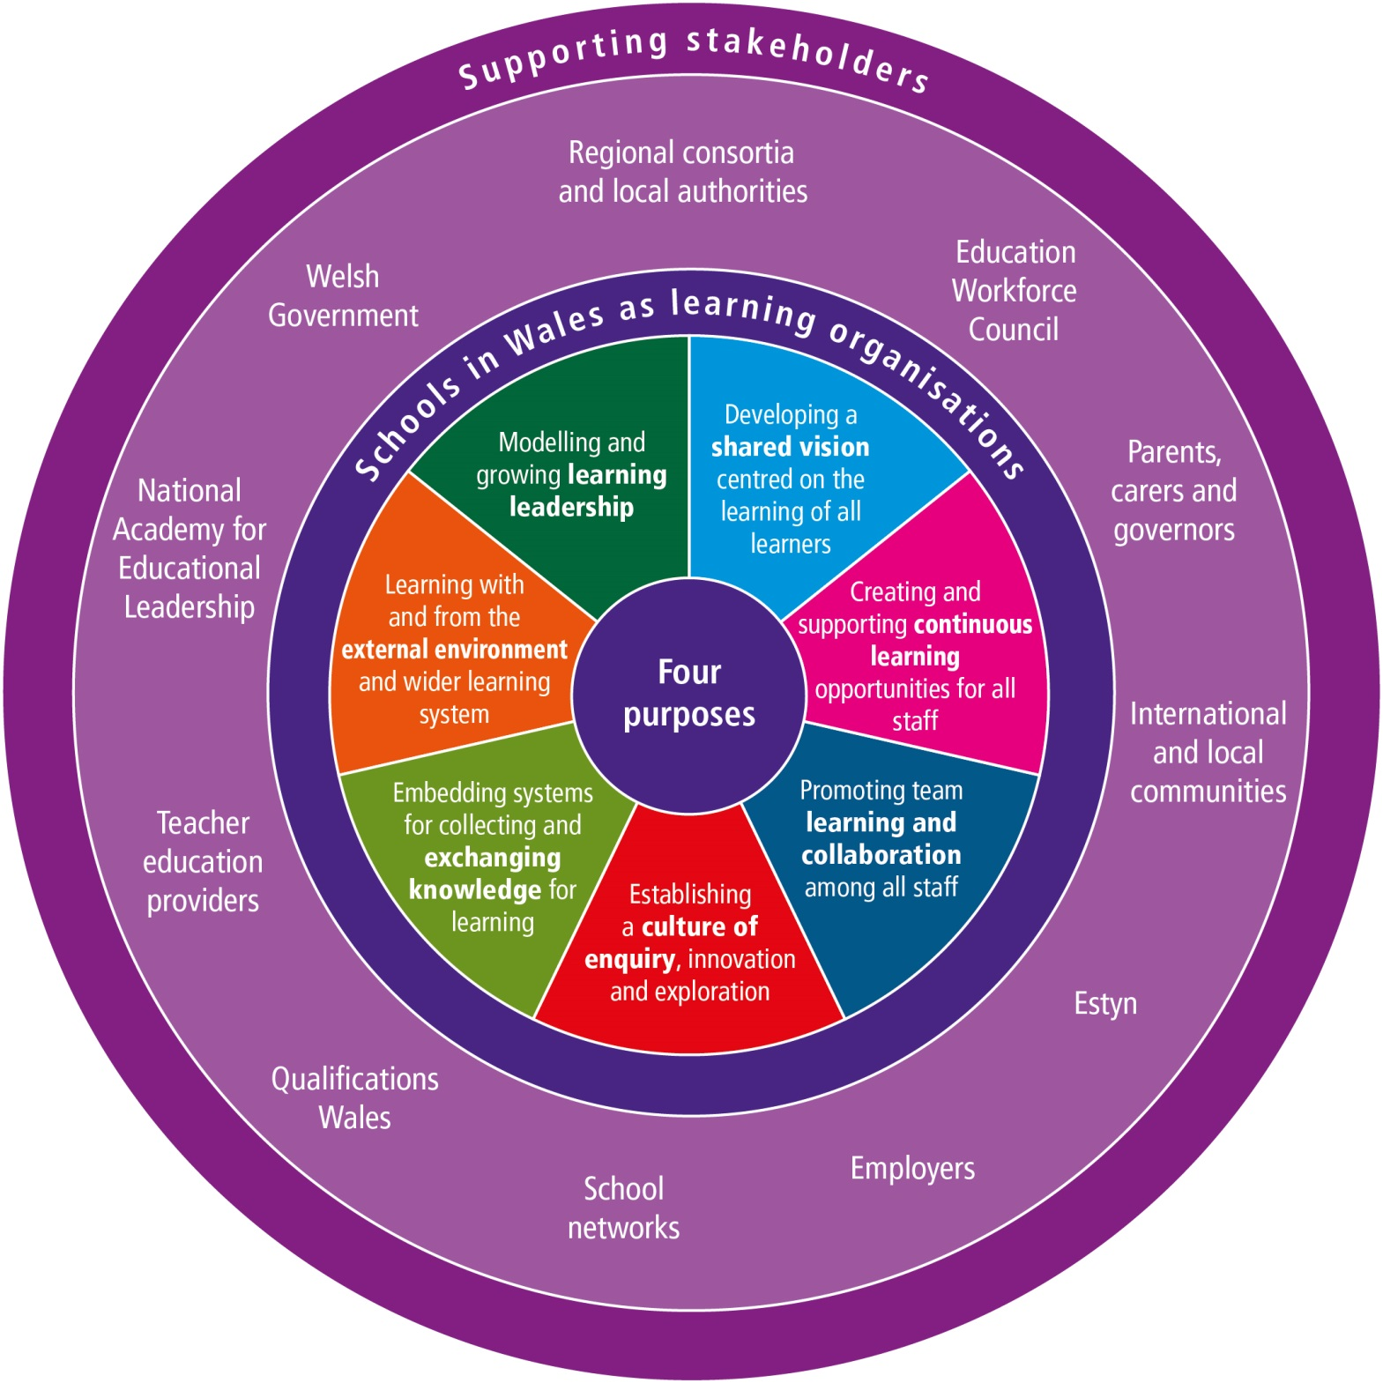
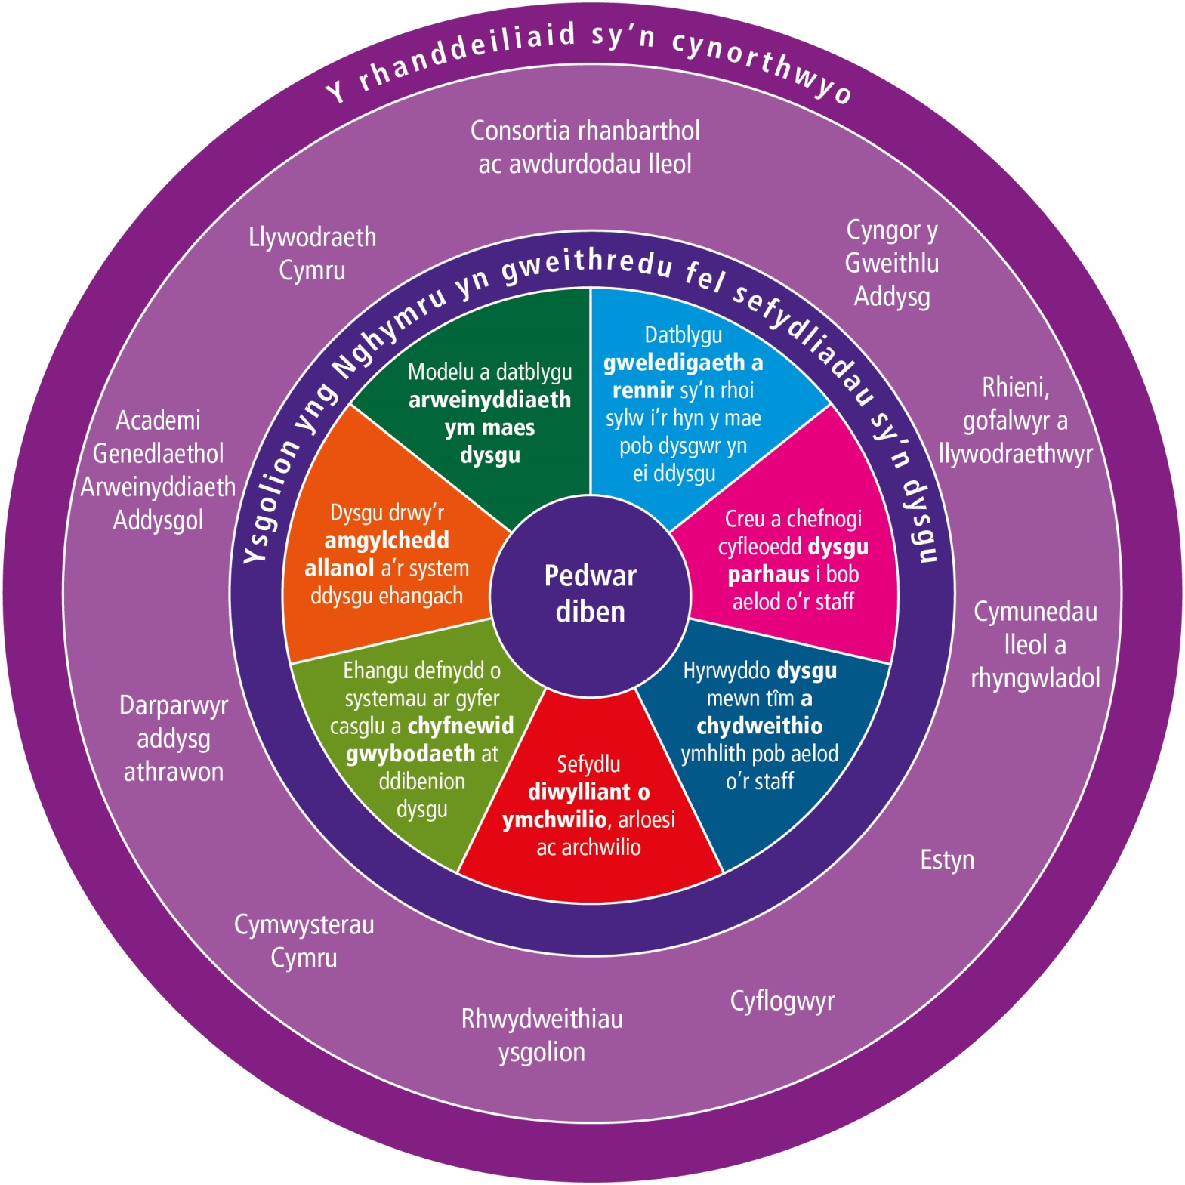
The SLO model for Wales focuses on realising seven ‘dimensions’ in our schools.
The seven action-oriented dimensions highlight the aspirational goals and processes to transform a school into a learning organisation.

Slide 4
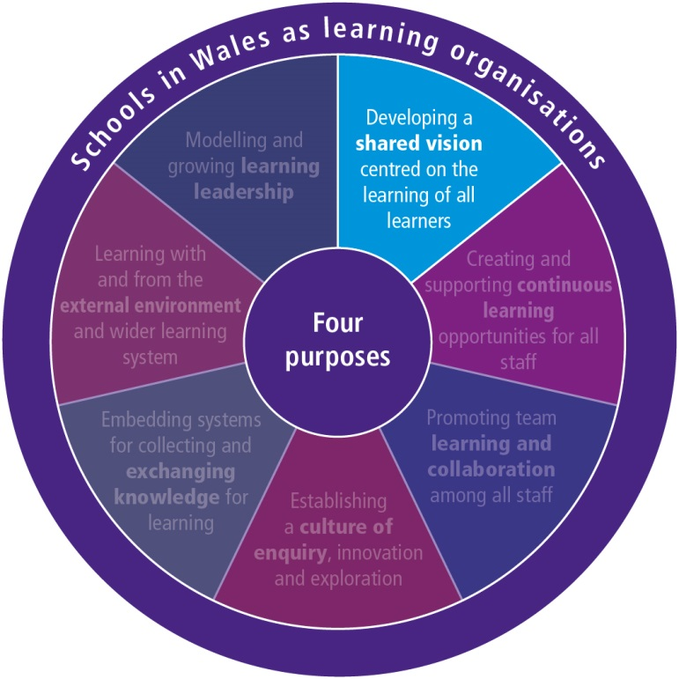
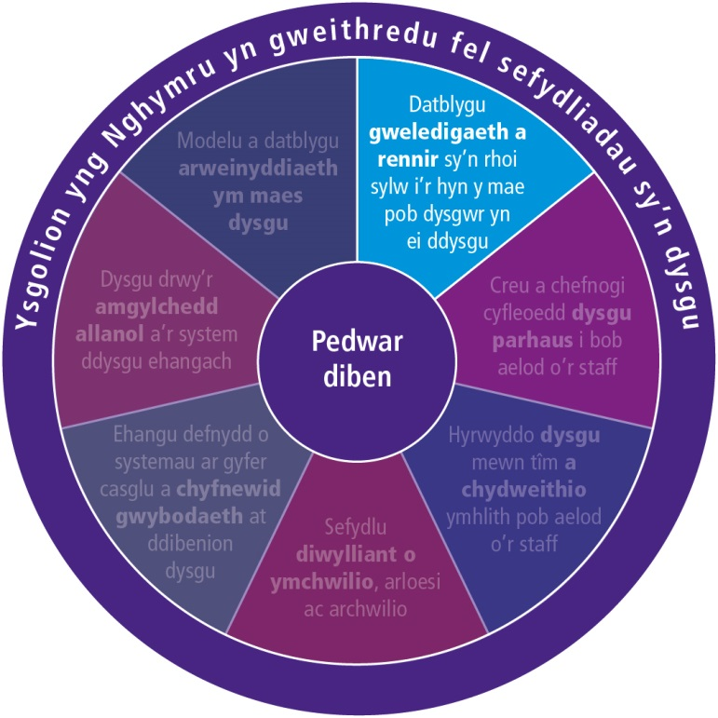
YSGolion FEL sy'n Sefydliadau Dysgu - Ystyried y SAITH dimensiwn – DATBLYGU
SLO – EXPLORING THE SEVEN DIMENSIONS - DEVELOPING
Learners, parents/carers, the external community and other partners are invited to contribute to the school’s vision.
A shared and inclusive vision aims to enhance the learning experiences and outcomes of all learners.
The school’s vision focuses on enhancing learners’ cognitive and social-emotional outcomes (including their well-being), encompasses both the present and the future, and is inspiring and motivating.
Learning and teaching are oriented towards realising the vision.
The school’s vision is the outcome of a process involving all staff, including governors and other stakeholders.

Slide 5
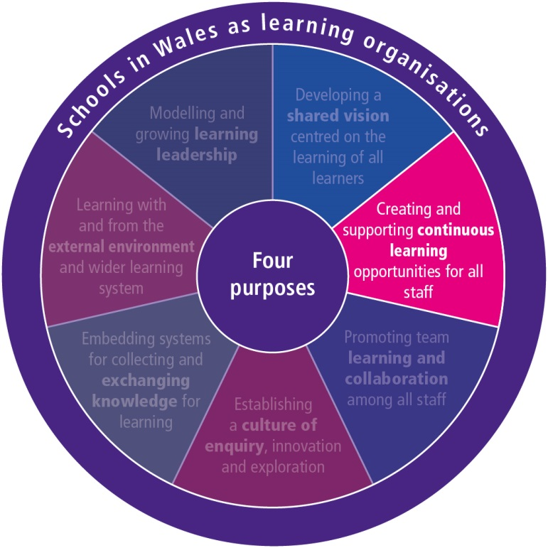
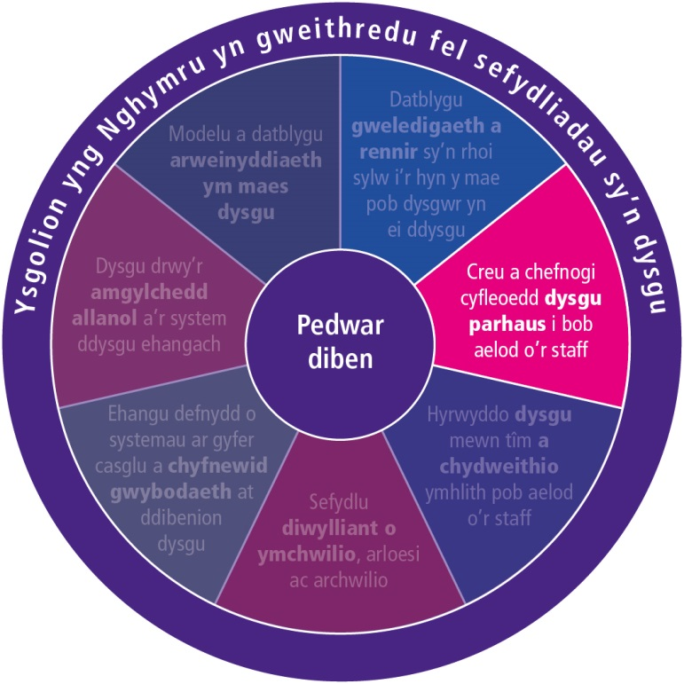
Ysgolion FEL sy'n Sefydliadau Dysgu - Ystyried y SAITH dimensiwn – creu
SLO – EXPLORING THE SEVEN DIMENSIONS – CREATING
Professional learning challenges thinking as part of changing practice.
Professional learning connects work-based learning and external expertise.
Professional learning is based on assessment and feedback from a range of sources including the learner.
Time and other resources are provided to support professional learning.
The school’s culture promotes and supports professional learning.
All staff engage in continuous professional learning to ensure their practice is critically informed and up to date.
New staff receive induction support.
All staff have access to coaching and mentoring support.
Professional learning is focused on the learner’s learning and the school’s goals.
Staff are fully engaged in identifying the aims and priorities for their own professional learning.

Slide 6
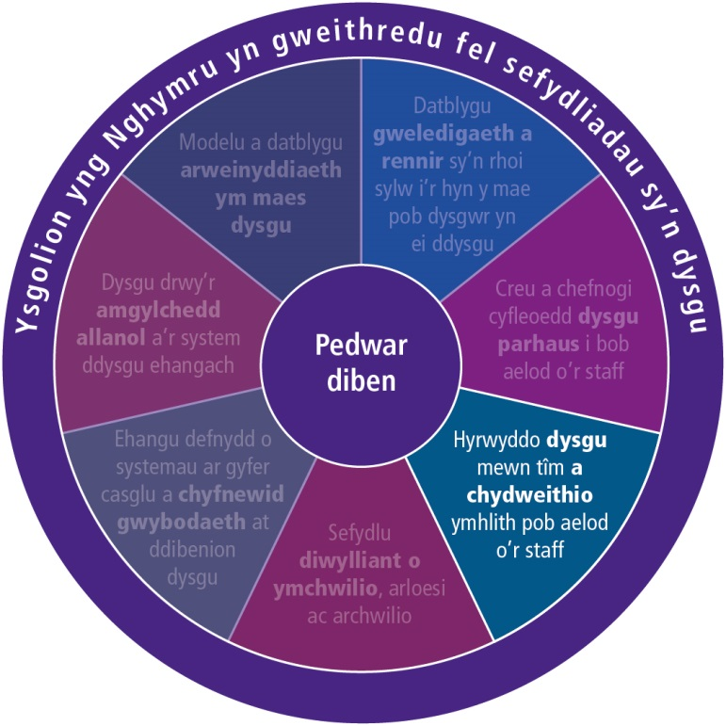
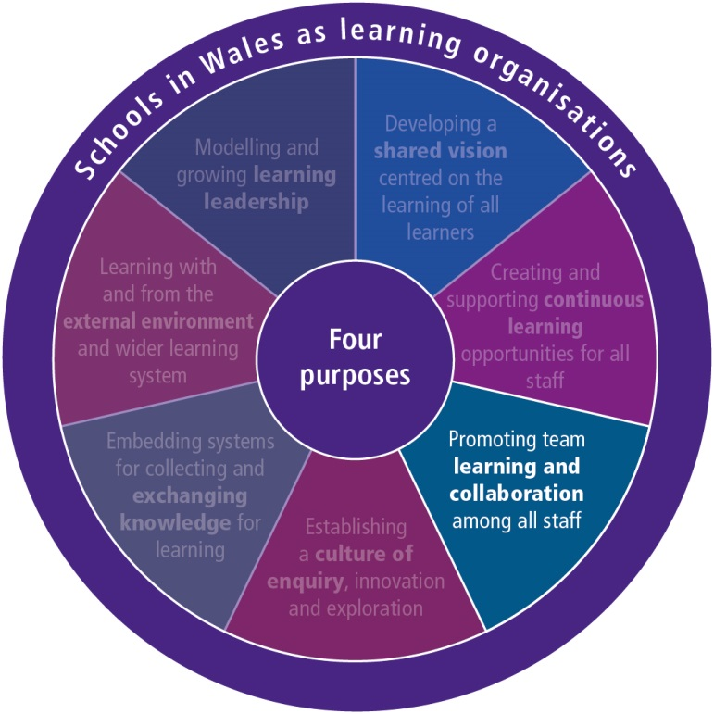
Ysgolion FEL sy'n Sefydliadau Dysgu - Ystyried y saith dimensiwn – HYRWYDDO
SLO – EXPLORING THE SEVEN DIMENSIONS - PROMOTING
Collaborative working and collective learning – face-to-face and/or using ICT – are focused and enhance learning experiences, learner outcomes and/or staff practice.
Staff reflect together on how to make their own learning more powerful.
Staff learn how to work together as a team.
Staff feel comfortable seeking advice from each other.
Trust and mutual respect are core values.
The school allocates time and other resources for collaborative working and collective learning.
Collaborative working and collective learning are central to the SLO.

Slide 7
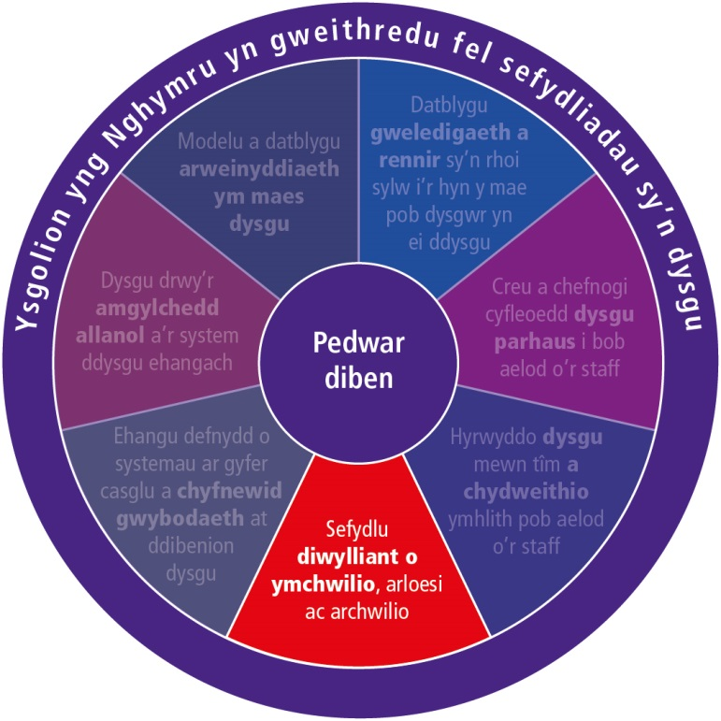
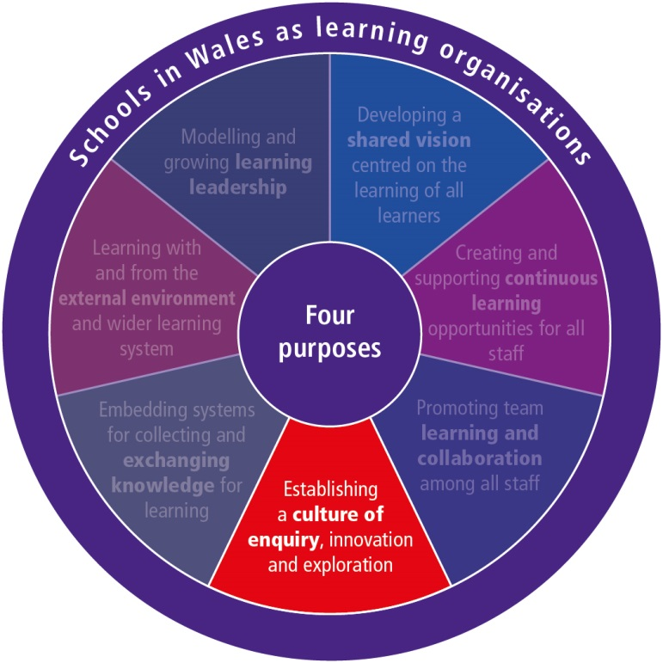
Ysgolion FEL sy'n Sefydliadau Dysgu - Ystyried y SAITH dimensiwn – SEFYDLU
SLO – EXPLORING THE SEVEN DIMENSIONS - ESTABLISHING
Staff are willing to take risks and experiment and innovate in their practice.
The school supports and recognises staff for taking initiative and risks.
Staff engage in forms of enquiry to investigate and extend their practice.
Enquiry is used to establish and maintain a rhythm of learning, change and innovation.
Staff are open to thinking and doing things differently.
Problems and failures are seen as opportunities for learning.
Learners are actively engaged in enquiry.

Slide 8
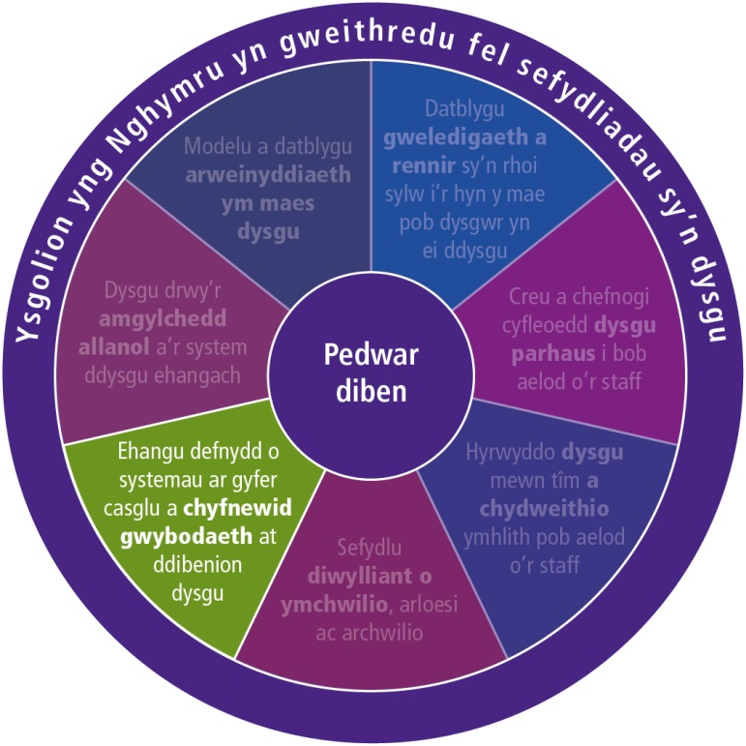
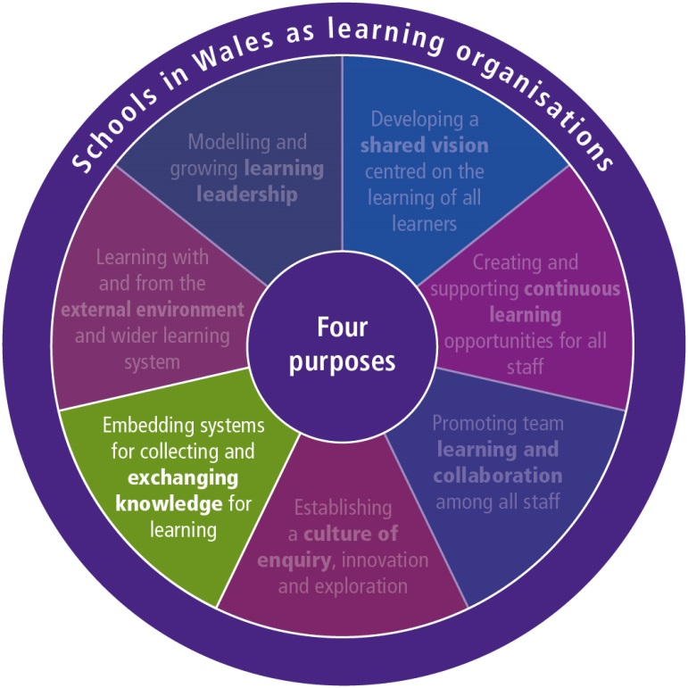
Ysgolion sy'n Sefydliadau Dysgu - Ystyried y SAITH dimensiwn – ehangu
SLO – EXPLORING THE SEVEN DIMENSIONS – EMBEDDING
Staff have the capacity to analyse and use multiple sources of data for feedback, including ICT, to inform teaching and allocate resources.
The school’s development plan is based on learning from continuous self-assessment and is updated at least once every year.
Staff regularly discuss and evaluate whether actions had the desired impact and change course if necessary.
The school evaluates the impact of professional learning.
Systems are in place to examine progress and gaps between current and expected impact.
Structures for regular dialogue and knowledge exchange are in place.
Examples of good and failed practices are made available to all staff to inform learning.
Sources of research evidence are readily available and easily accessed and are used by staff to improve their practice.

Slide 9
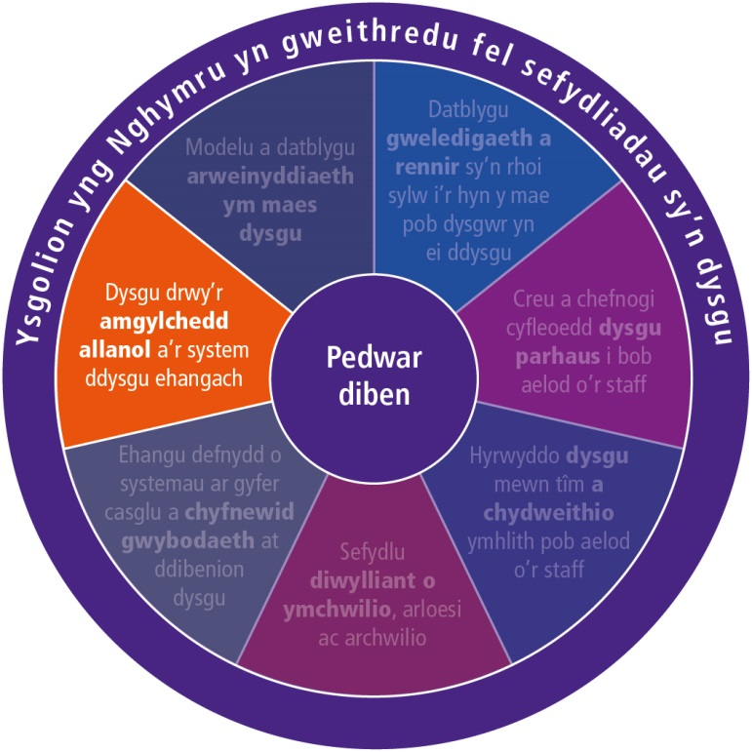
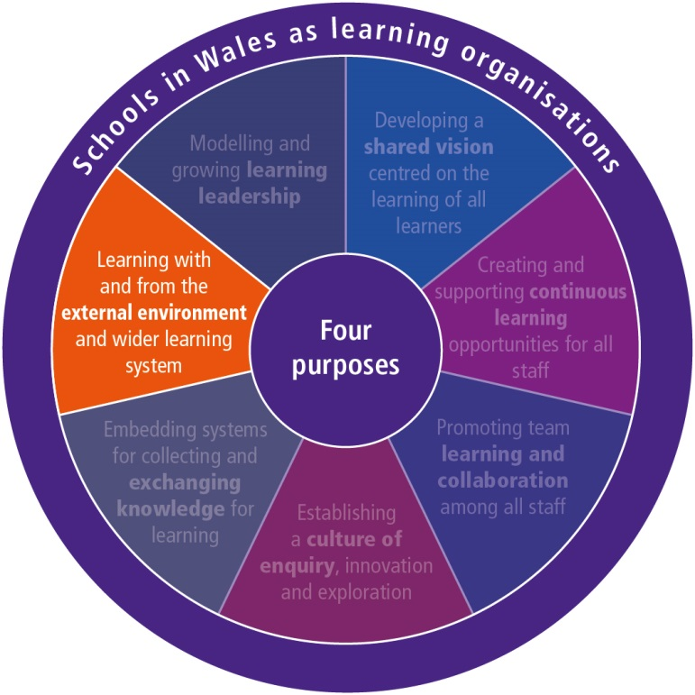
The school forms partnerships with higher education institutions, businesses, and/or public or non-governmental organisations in efforts to deepen and extend learning.
Partnerships are based on equality of relationships and opportunities for mutual learning.
ICT is widely used to facilitate communication, knowledge exchange and collaboration with the external environment.
The school is an open system, welcoming approaches from potential external collaborators.
The school scans its external environment to respond quickly to challenges and opportunities.
Staff collaborate, learn and exchange knowledge with peers in other schools through networks and/or school-to-school collaborations.
The school collaborates with parents/carers and the community as partners in the education process and the organisation of the school.
Ysgolion fel sy'n Sefydliadau Dysgu - Ystyried y saith dimensiwn – dysgu
SLO – EXPLORING THE SEVEN DIMENSIONS – LEARNING

Slide 10
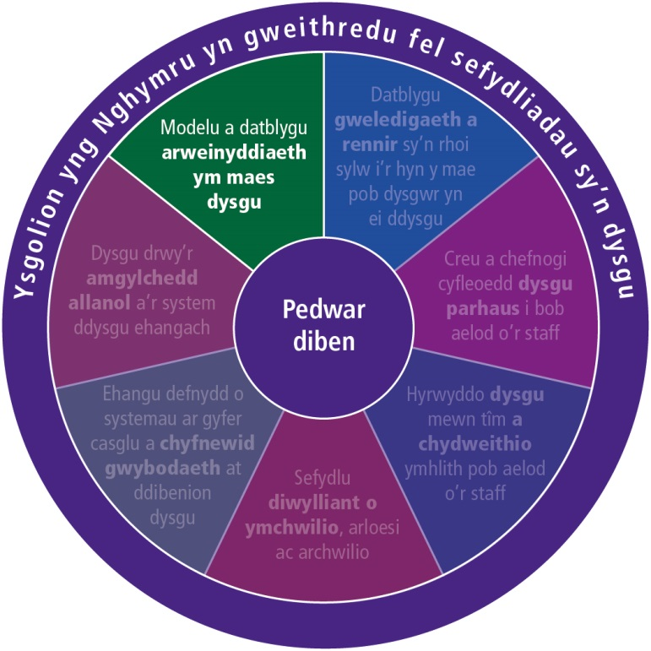
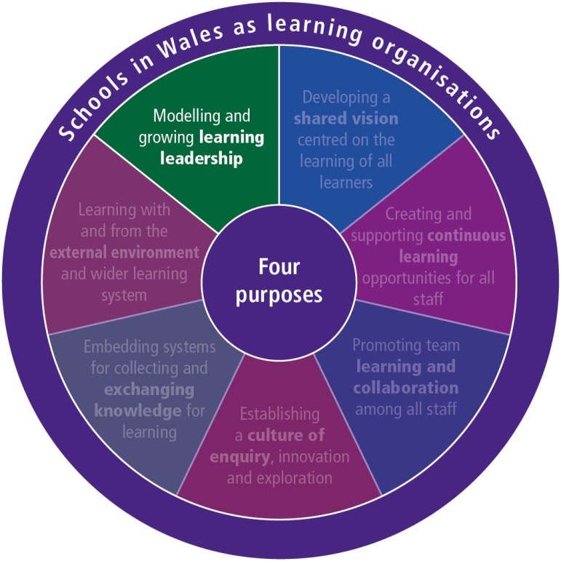
YSGolion FEL sy'n Sefydliadau Dysgu - Ystyried y saith dimensiwn – MODELU
SLO – EXPLORING THE SEVEN DIMENSIONS – MODELLING
School leaders ensure that the organisation’s actions are consistent with its vision, goals and values.
School leaders model learning leadership, distribute leadership and help grow other leaders, including learners.
School leaders are proactive and creative change agents with a strong focus on improving learning and teaching.
School leaders ensure the school is characterised by a ‘rhythm’ of learning, change and innovation.
School leaders develop the culture, structures and conditions to facilitate professional dialogue, collaboration and knowledge exchange.
School leaders promote and participate in strong collaboration with other schools, parents/carers, the community, higher education institutions and other partners.
School leaders ensure an integrated approach to responding to learners’ learning and other needs.
Leadership is the essential iseven SLO dimensionsngredient connecting the.

Slide 11
Ymddiried Trust
Amser Time
Technoleg Technology
Meddwl gyda
‘n gilydd Thinking Together

Slide 12
Camau nesaf/Next steps
Cwblhewch yr arolwg
Complete the survey
Hwb
Gosod llinell amser
Set a timeline
Dyma’ch canlyniadau
These are your results
Adolygu
Review
Gwerthuso
Evaluate
Cynllunio
Plan
Datblygu
Develop

Slide 13
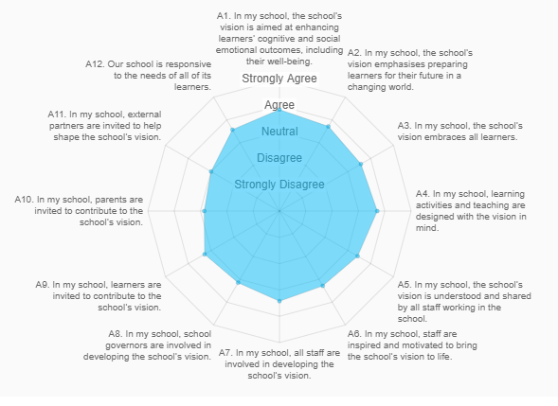
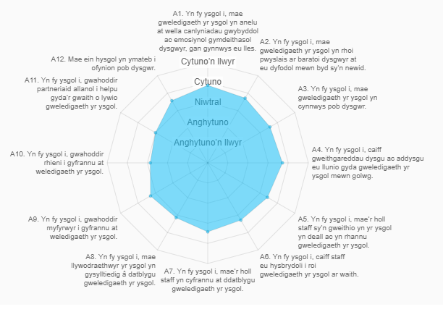
Canlyniadau/Results

Slide 14
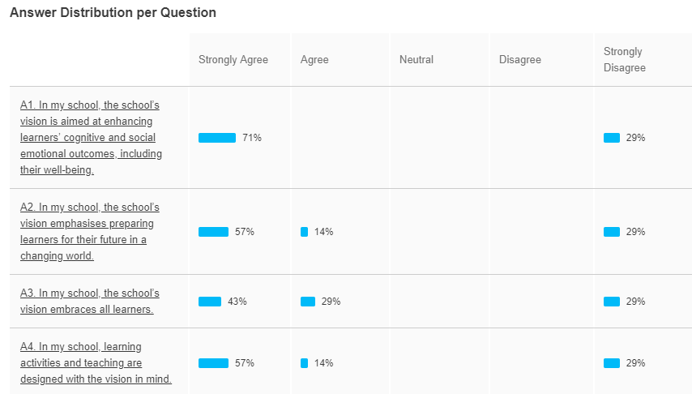
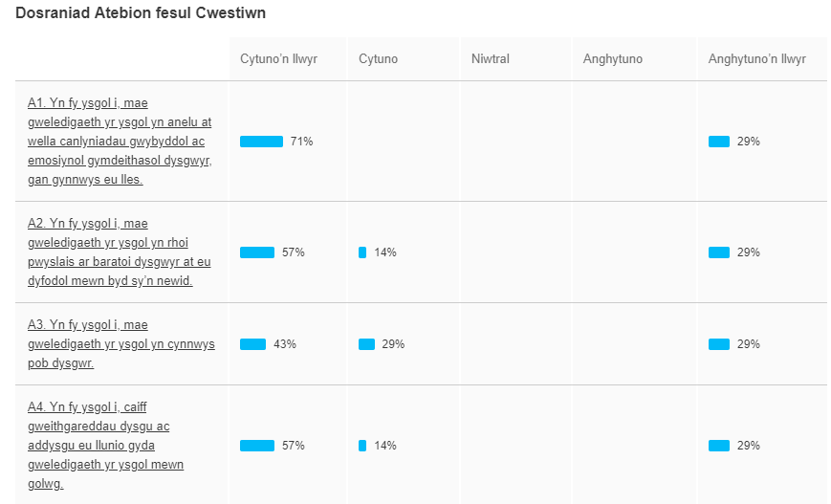
Canlyniadau/Results

Slide 15
Summary

Slide 16
Reflection/Myfyrio
“Intelligent people are in continuous learning mode. Their confidence in combination with their inquisitiveness, allows them to constantly search for new and better ways . They are always striving for perfection, always growing, always learning, always modifying and improving themselves. They seize problems, situations, tensions, conflicts and circumstances as valuable opportunities to learn.”
Art Costa from “ Schools that Learn” Peter Senge

Slide 17
Cyswllt/Contact
Ann.Bradshaw@gov.wales

