Slide 1
The National Approach to
Professional Learning

Slide 2
A Simple Definition of Professional Learning in Wales
Professional…
In-post, or in a break from post
Career long and continuous
Formal and informal
Specific to current or future requirements of the post or the practitioner
Linked to wider professional development and performance
Linked to a set of professional standards
Learning…
Enhancement in knowledge
Development of new skills
Changes in attitude
All of the above
Brought about via a wide range of experiences, ranging from self-propelled research and investigation to structured instructional and assessment programmes
So…
There is learning that is not professional
There is professional behaviour that is not learning
Learning a new scale on the violin is not professional learning…
Unless you’re a professional violinist
Synonyms…
CPD
Training
INSET
#CenhadaethAddysgCymru
#EducationMissionWales
Notes:
Kp notes from v12 update
May need a 3d interactive model

Slide 3
Why do we need a National Approach to Professional Learning?
At the heart of the Welsh education story is curriculum reform. The new curriculum will call on all practitioners to think afresh about what they teach, how they teach and about what we want young people to be as well as to learn. Leaders and teachers will be afforded higher levels of autonomy and agency in schools and classrooms, and with this will come the need to develop new skills and approaches.
The Welsh Government document Education in Wales: Our national mission sets out the Welsh Government’s priorities for the education system for the period to 2021. Page 27 states that during the autumn of 2018 we will launch a national approach to professional learning (PL) (to include teachers/practitioners, learning support and supply staff).
It is clear as we develop the National Approach to Professional Learning that there is variation across Wales in PL provision and experiences. From the current Initial Teacher Education (ITE) programme, through regions’ support for newly qualified teacher (NQT) induction, to PL provision for serving practitioners and leaders and the research and learning that practitioners engage in, there is too much variation in access and entitlement, in the quality of PL experiences and in the impact of PL on practice and outcomes for schools and learners.
The National Approach to Professional Learning will address this by giving the system a model of interconnected elements that:
Set out the entitlement of all participants in the system, so that leaders and practitioners across all schools and settings know what to expect from the middle tier in terms of provision and support and from government in terms of policy
Express design criteria for PL activities, resources and processes, and so guide providers across the system on how provision and experiences should be designed
Describe the Welsh Government’s expectations of the system’s behaviour, and so make policy and resourcing decisions transparent to the middle tier and schools

Slide 4
The Key Elements of our National Approach to Professional Learning
The school learner is at the centre of our national approach. PL should be intended and designed to exert optimum impact on school learners’ experiences and achievements.
#CenhadaethAddysgCymru
#EducationMissionWales
Notes:
This is…
A design test when providers are developing their offers – what difference will it make to learners in schools if we offer this?
A question individuals planning their own learning journeys should ask – how will this make a difference to my practice and impact on my learners?
A question that Welsh Government should ask when deciding whether to fund or otherwise support providers’ offers – will this provision have an impact on learners?

Slide 5
The Key Elements of our National Approach to Professional Learning
The new curriculum is driven by the four purposes, and just as they are at the heart of learning in schools, they need to be at the heart of the professional learning experiences of practitioners at all levels of the system.
#CenhadaethAddysgCymru
#EducationMissionWales
Notes:
This is…
A design test when providers are developing their offers – are the purposes properly referenced in the PL and do they support and enhance PL?
A question individuals planning their own learning journeys and activities should ask – how will this make a difference to my practice and support my learners to achieve the purposes?
A question that Welsh Government should ask when deciding whether to fund or otherwise support providers’ offers – will this provision bring us closer to a school system driven by and achieving the purposes?

Slide 6
The Key Elements of our National Approach to Professional Learning
The professional learner is near the centre of our national approach. PL should be intended and designed to be a personalised response to individual professional learners’ needs, taking into account their experience, expertise and aspirations.
#CenhadaethAddysgCymru
#EducationMissionWales
Notes:
This is…
A design test when providers are developing their offers – is the offer inclusive of all potential participants, and is it flexible enough to be valuable across a range of professional learning needs and approaches?
A question individuals planning their own learning journeys should ask – how will this make a difference to me as a professional now and in the future?
A question that Welsh Government should ask when deciding whether to fund or otherwise support providers’ offers – is this provision appropriately ambitious and nuanced across the whole community of professional learners?

Slide 7
The Key Elements of our National Approach to Professional Learning
The school, regional and national context define the priorities for PL…
School – the nature of the cohort and community, the opportunities and challenges to the school, school-level skills and expertise
Regional – priorities defined by the regional consortia and their LAs
National – national priorities in curriculum reform – defined by the key themes in the mission…
The requirements of the new curriculum
Assessment, evaluation and accountability
Equity and equality – the needs of specific groups
Wellbeing
Challenging the impact of poverty
Transition and transfer
The Welsh language
School Learner
In our national approach, PL experiences should always map clearly to the school, regional and national context of those experiences.

Slide 8
The Key Elements of our National Approach to Professional Learning
The eight interconnected elements…
Pedagogy – applies to the design of PL
PLO and time – applies to the time we allocate to PL, to how professionals use the time allocated to them and how the middle tier expresses its offer
Accreditation – applies to formal qualifications that come with PL. Recognition is system-wide acknowledgement of the value of specific PL activities (e.g. NPQH)
The Professional Teaching and Leadership Standards act as the basis of the curriculum for PL
Collaborative networks act as the human and social infrastructure for PL experiences
The Individual Professional Learning Journey is an entitlement for all professionals
The Learning Organisation is the institutional frame in which professionals work
The PL blend refers to the blend of instructional, research, peer and e-learning that best fits the learner and the area of work

Slide 9
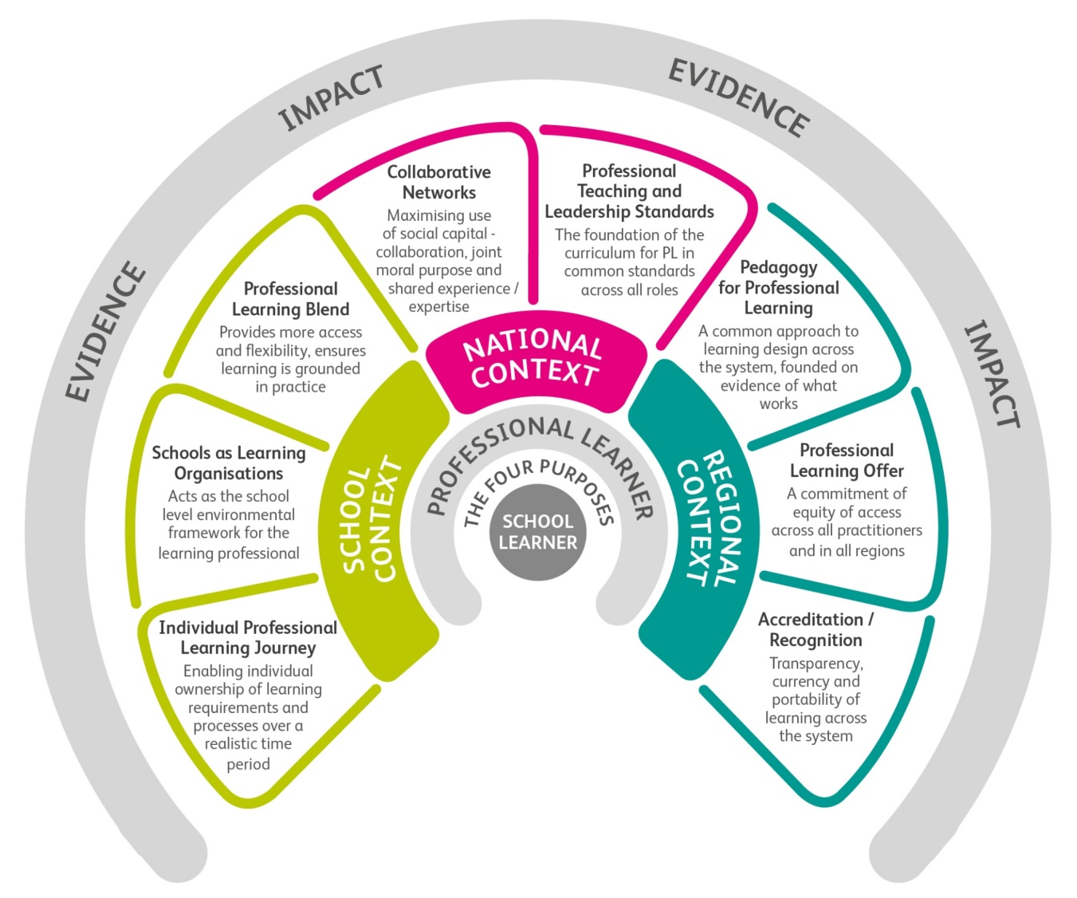
The Key Elements of our National Approach to Professional Learning
Evidence and Impact…
In our national approach, all PL is premised and designed on the basis of evidence for its need – a wide range of sources is available to underpin evidence of PL need at individual, school, regional and national level.
Impact is the change we bring about in practice, and the effect this has on learning experiences and outcomes, and needs to be evidenced as part of PL design.
So an effective PL process, whatever its detailed design, intent or outcomes, starts with evidence of need, sets out its intended impact , determines the changes that have taken place, and specifies the impact of these on learning and outcomes.

Slide 10
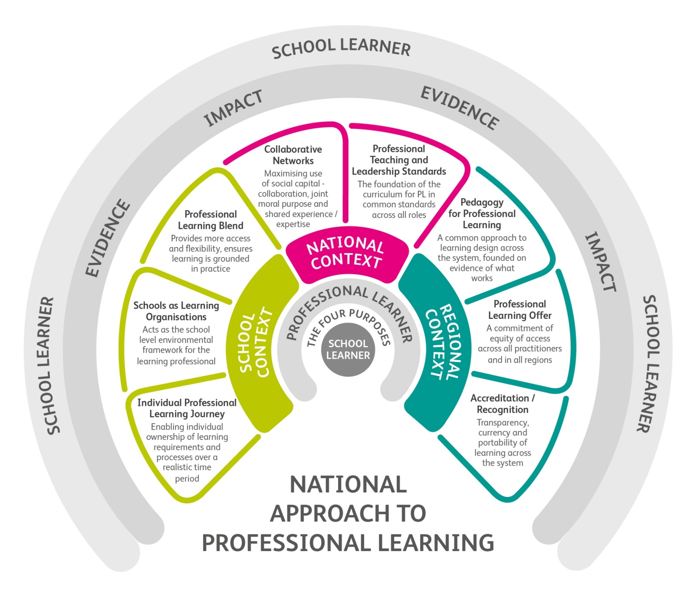
The Key Elements of our National Approach to Professional Learning
Back to the school learner
Just as we began by putting the learner in school at the centre of the model, we end by putting her or him around the outside – just to show that [professional learning starts and ends with the best interests of learners in schools
School learner

