Slide 1

Digital Competence Framework
Update – June 2018
Notes:
Purpose of presentation
To update you on what has happened since the publication of Digital Competence Framework (DCF) in September 2016.
To inform you of some key milestones and ongoing work following the launch of Education in Wales: Our national mission, Action plan 2017–21.
To remind practitioners of key messages regarding the DCF.

Slide 2
Progress to date
The DCF was available to settings and schools in September 2016.
The DCF was refined in 2017 following feedback from practitioners; there are no more changes due until new curriculum is in place.
A mapping tool is available for cross-referencing elements of the DCF with your current teaching, which helps you plan to cover the full range of skills within each element.
Professional learning needs tool is available on Hwb.
Notes:
This is a brief outline of the developments following the launch of the DCF.
Taking account of feedback from settings, schools and wider stakeholders, we made refinements which were incorporated into the current version of the DCF in September 2017.
We initially developed and incorporated classroom task ideas within the interactive framework. Following advice from our Digital Pioneer Schools, more ideas and tasks have been added to Hwb where they can be adapted to ensure they are suitable for your classroom or setting.
The mapping tool lets you cross-reference elements of the DCF with your current teaching in subjects and years. As you add your information, the tool shows your levels of DCF coverage.
The professional learning needs tool available on Hwb is designed to help practitioners identify the areas where they already feel confident and areas where they feel they need further development.
The next slides give a representation of the structure of the DCF.

Slide 3
Strands of the DCF
Citizenship.
Interacting and collaborating.
Producing.
Data and computational thinking.
Notes:
The DCF includes high-level skill statements, which are grouped into four strands.
Each strand is then sub-divided into elements, which are shown over the next four slides.

Slide 4
Citizenship
Identity, image and reputation.
Health and well-being.
Digital rights, licensing and ownership.
Online behaviour and cyberbullying.
Notes:
There are four elements for the Citizenship strand.

Slide 5
Interacting and collaborating
Communication.
Collaboration.
Storing and sharing.
Notes:
There are three elements for the Interacting and collaborating strand.

Slide 6
Producing
Planning, sourcing and searching.
Creating.
Evaluating and improving.
Notes:
There are three elements for the Producing strand.

Slide 7
Data and computational thinking
Problem solving and modelling.
Data and information literacy.
Notes:
There are two elements for the Data and computational thinking strand.

Slide 8
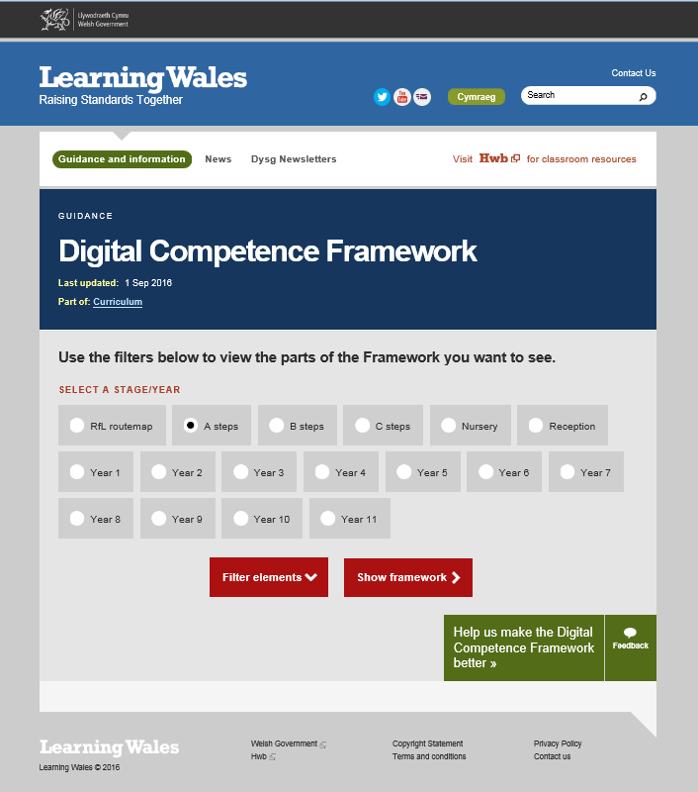
The interactive DCF
Notes:
A digitally published version of the DCF has been produced.
These screenshots demonstrate how it appears.
There are also a number of short animated demonstrations of the digital version accessible on Learning Wales. (learning.gov.wales/resources/browse-all/digital-competence-framework)

Slide 9
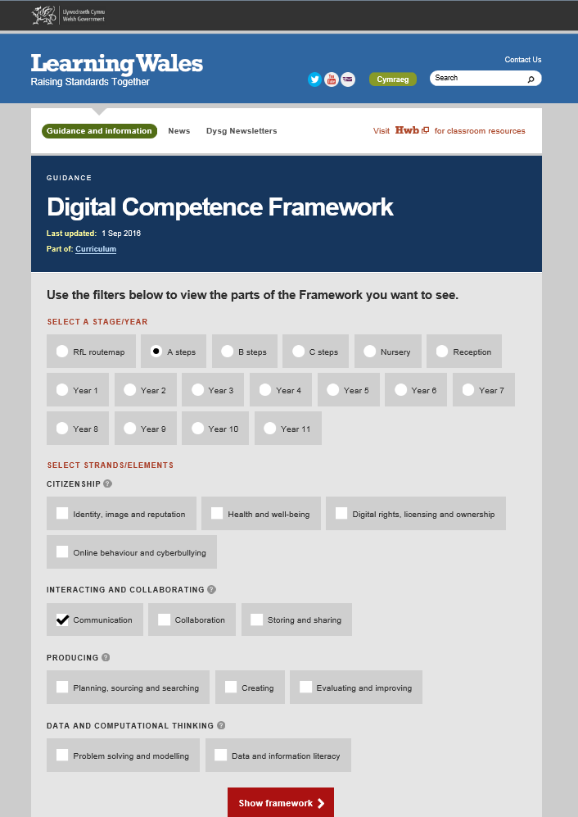
The interactive DCF

Slide 10
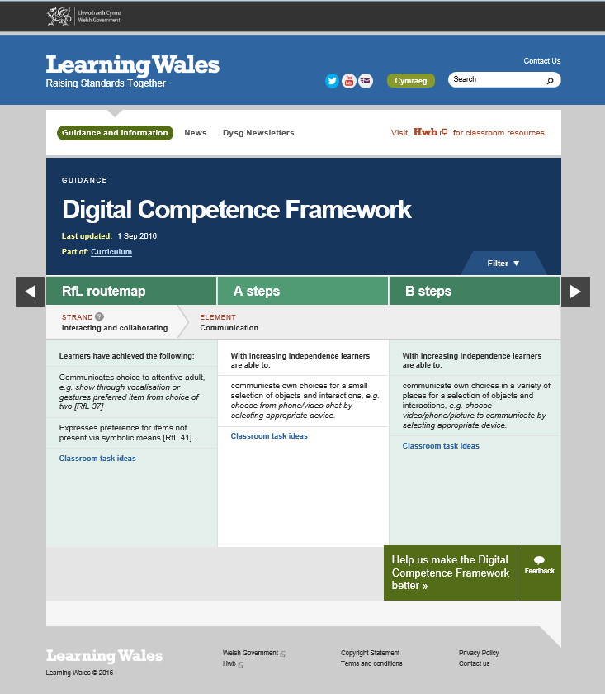
The interactive DCF

Slide 11
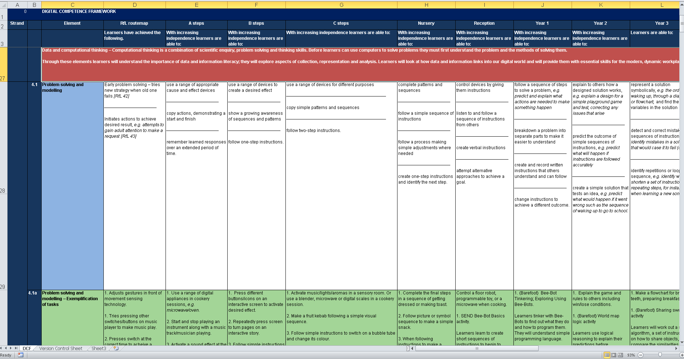
The DCF in spreadsheet format
Notes:
This is an extract from the spreadsheet version of the DCF.
Skills are arranged to show progression, currently shown in year groups. This will be reviewed as the concept of progression steps develops.

Slide 12
Using the DCF
By September 2018 our expectations are that settings/schools would have:
developed a clear vision for digital learning
developed policies and procedures to prepare for embedding digital competence
identified a lead responsible for digital competence
incorporated digital competence into school improvement plans
undertaken a mapping exercise of delivery of digital competence
undertaken staff audits and identified professional learning requirements.
Notes:
We have re-iterated our commitment with Education in Wales: Our national mission, Action plan 2017–21 which sets out how the school system will move forward over the period 2017–21, securing implementation of the new curriculum with a focus on leadership, professional learning, and excellence and equity within a self-improving system.
We are committed to ensuring that all our learners in Wales will have higher standards of literacy and numeracy, and become more digitally and bilingually competent, to evolve into enterprising, creative and critical thinkers.

Slide 13
Key actions for senior leaders
Read through Successful Futures (especially cross-curricular responsibility).
Facilitate a school-wide discussion for a digital vision – ‘Why, What and How’. This should draw on representatives from learners, teachers, governors and parents/carers.
Undertake a comprehensive review of learner, staff and governor knowledge, attitude and application of digital learning.
Visit other schools and consider effective practice in context.
Whole-school INSET relating to digital learning and how it fits with wider pedagogy priorities.
Include digital learning as a school priority in department improvement plan/
school improvement plan/school self-evaluation.
Conduct 360 degree safe Cymru on Hwb.
Review resources and consider deploying or redeploying for better access. Think more imaginatively with existing resources and then make a plan for any necessary resource requirements.
Hold whole-school training looking at digital learning and digital competence, including specific training on strands and elements where appropriate.

Slide 14
Key actions for middle leaders
Examine case studies from other settings/schools.
Promote triad working looking at provisions of digital learning.
Promote the reading of academic papers and research.
Use the DCF mapping tool to identify areas for development.
Conduct pupil voice regarding technology in lessons.
Investigate or receive training on how their subject discipline can be enhanced with technology.
Begin to combine digital activities with their subject teaching, including independent learner research and creation.

Slide 15
Key actions for classroom teachers
Discuss with other staff members in setting/school and realise the value of digital learning to your learners and your
well-being.
Conduct pupil voice regarding technology in lessons.
Research online, e.g Microsoft Educators Community, Google for Education BlogSpot.
Read up-to-date school policies linking to all matters digital.
Familiarise yourself with digital learning and digital competence in your department improvement plan and your school development plan.
Collaborate across subject areas on a project that includes aspects of digital creation or incorporate a number of subject themes within a larger project, using digital technologies.

Slide 16
Taking the DCF forward
From September 2018, settings and schools will:
have a clear vision for delivering digital competence in the classroom across the curriculum
have established staff responsibilities for embedding digital competence across the curriculum
review on an ongoing basis:
– hardware/software requirements
– staff professional learning needs
be mapping digital competence against department/year of current curriculum
have planned for and be delivering staff professional development in respect of digital competence, working with regional consortia.

Slide 17
Next steps for the curriculum
January 2018 – Digital Pioneers join Area of Learning and Experience (AoLE) groups to advise on digital learning across the curriculum.
April 2019 – The new curriculum and assessment arrangements will be available for feedback.
September 2022 – The new curriculum will be introduced to Nursery through to Year 7 and settings/schools will have embedded digital competence across the school curriculum.
September 2022 onwards – Curriculum roll-out to
Year 11 continues year on year to 2026.
Notes:
More classroom task ideas are available on Hwb.

