Slide 1
Safonau proffesiynol ar gyfer addysgu ac arweinyddiaeth
a
safonau drafft ar gyfer cynorthwyo addysgu
Professional standards for teaching and leadership
and
draft standards for assisting teaching

Slide 2
Professional standards
The context of the new professional standards…why do we need them?
The architecture of the new professional standards
Values and dispositions and 5 standards
Using the standards with teachers
A glimpse at some descriptors for leadership and reviewing
The developing scene for TAs and HLTAs
Where the standards fit with other aspects of performance management
What next…and questions

Slide 3
Professional standards
The context of the new professional standards…why do we need them?
The architecture of the new professional standards
Values and dispositions and 5 standards
Using the standards with teachers
A glimpse at some descriptors for leadership and reviewing
The developing scene for TAs and HLTAs
Where the standards fit with other aspects of performance management
What next…and questions

Slide 4
Our national mission: the Welsh education agenda…
Reform….Curriculum for Wales, Qualified for Life, Teaching Tomorrow’s Teachers now in Education in Wales: our national mission 2017-21
Curriculum and qualifications…Welsh language and culture
ALN, ACEs
Initial teacher education
National Academy for Educational Leadership
Professional standards…teaching, leadership, assisting teaching
Accountability…inspection…categorisation…performance measures reform
School teachers’ pay and conditions

Slide 5
Our national mission - helping professionalism to flourish…
building a community of professionals
prioritise professional learning for all staff
with opportunity for staff to work in teams on professional enquiry
build teams to include teachers, assistants and support staff
and teach them to work well together
to benefit every learner in Wales

Slide 6
Helping professionalism to flourish…the new standards…
once through QTS and induction less about evidence and proof…more about trust
more about building belief and practice…less about checking
more about building the team…and shared professional accountability
more about growth and development…less about jumping through hoops
all about getting the best outcomes for pupils

Slide 7
Professional standards
The context or the new professional standards…why do we need them?
The architecture of the new professional standards
Values and dispositions and 5 standards
Using the standards with teachers
A glimpse at some descriptors for leadership and reviewing
The developing scene for TAs and HLTAs
Where the standards fit with other aspects of performance management
What next…and questions

Slide 10
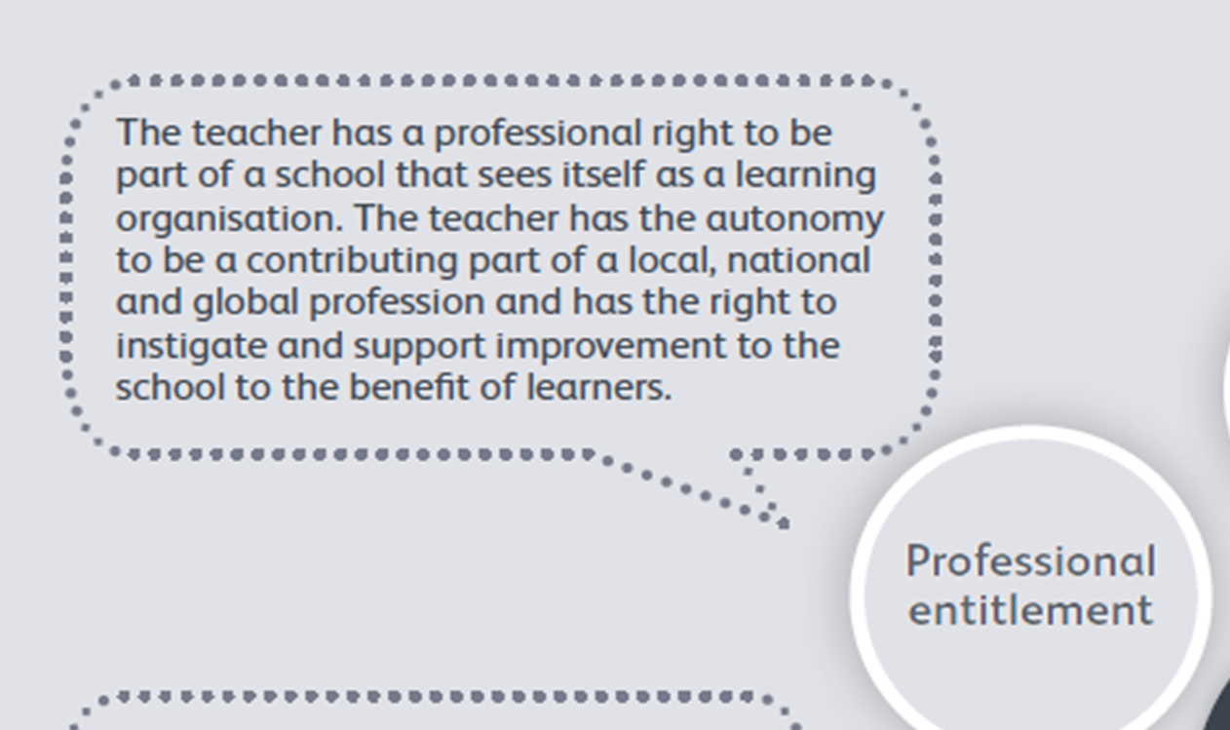

Slide 12
Professional standards
The context or the new professional standards…why do we need them?
The architecture of the new professional standards
Values and dispositions and 5 standards
Using the standards with teachers
A glimpse at some descriptors for leadership and reviewing
The developing scene for TAs and HLTAs
Where the standards fit with other aspects of performance management
What next…and questions

Slide 19
Using the standards…with individual teachers and teams
encourage each individual to document success (professional learning passport)
analyse successes with them
over the course of a year, record examples of things like…
most successful examples of teaching
a well organised educational visit
a display or activity that stimulates further learning
a useful contribution to a staff meeting
involvement in an extended curriculum development group
sensitively handling a delicate matter with a parent/carer
developing a ‘new’ facet of teaching
suggesting a change to a school policy
linking with an employer
engaging with research

Slide 20
Using the standards as part of continuous improvement
fix a dedicated time with the teacher
have a list of considerations per standard
start with the teacher’s record (PLP) and explore the descriptors
so these were strong contributions…
how do you know?
what is the impact?
are the 5 standards in balance?...why not?
how do we spread the good things?
who could you help?
how can we help you?
…ambitions for next time?

Slide 21
Helping professionalism to flourish
treat every individual teacher as a precious resource
enable senior leaders and other particularly qualified staff to model good teaching throughout the school
show that leadership is committed to learning the Welsh language
involve staff voice on policy decisions
and encourage individual and team growth

Slide 22
Professional standards
The context or the new professional standards…why do we need them?
The architecture of the new professional standards
Values and dispositions and 5 standards
Using the standards with teachers
A glimpse at some descriptors for leadership and reviewing
The developing scene for TAs and HLTAs
Where the standards fit with other aspects of performance management
What next…and questions

Slide 32
With individuals in formal leadership positions…
encourage each individual to document success (PLP)
analyse successes with them
over the course of a year, record examples of things like…
most successful examples of improving teaching
a successful example of supporting a colleague
a way in which a team has been developed
effective strategic development
the school’s involvement in an extended network of learning
building parent/ carer trust
dealing with disciplinary matters
ensuring school policy in practice
developing professional learning impact with colleagues
contributing to development in other schools

Slide 33
Using the leadership standards…as reviewer
fix a dedicated time with the leader
have a list of considerations per standard
start with the leader’s record (PLP) and explore the descriptors
so these were strong contributions…
how do you know?
what is the impact?
are the 5 standards in balance?...why not?
how do we spread the good things?
who could you help?
how can we help you?
…ambitions for next time?

Slide 34
Professional standards
The context or the new professional standards…why do we need them?
The architecture of the new professional standards
Values and dispositions and 5 standards
Using the standards with teachers
A glimpse at some descriptors for leadership and reviewing
The developing scene for TAs and HLTAs
Where the standards fit with other aspects of performance management
What next…and questions

Slide 35
Refining teaching…assisting effectiveness and efficiency
Sustained highly effective practice
Managing the learning environment
Effective practice
Helping with assessment
Helping to provide appropriate resources
Involving families in learning
Assisting Teaching

Slide 36
PEDAGOGY: Refining teaching…assisting effectiveness and efficiency
Managing the learning environment
The teaching assistant takes responsibility for the maintenance of aspects of the school environment to a high standard and for improving aspects as necessary.
The teaching assistant supports the teacher in making the learning environment efficient, effective and dynamic in terms of organisation and promoting learning in line with the school’s vision.
Assisting Teaching

Slide 37
PEDAGOGY: Refining teaching…assisting effectiveness and efficiency
Managing the learning environment
The teaching assistant takes responsibility for the maintenance of aspects of the school environment to a high standard and for improving aspects as necessary.
The teaching assistant supports the teacher in making the learning environment efficient, effective and dynamic in terms of organisation and promoting learning in line with the school’s vision.
Assisting Teaching

Slide 38
PEDAGOGY: Refining teaching…assisting effectiveness and efficiency
Managing the learning environment
The teaching assistant takes responsibility for the maintenance of aspects of the school environment to a high standard and for improving aspects as necessary.
The teaching assistant supports the teacher in making the learning environment efficient, effective and dynamic in terms of organisation and promoting learning in line with the school’s vision.
Assisting Teaching

Slide 39
Influencing learners…assisting their positive outlook
Sustained highly effective practice
Observing learners
Effective practice
Listening to learners
Learners leading learning
Helping to build effort in learners
Learning outcomes and well-being
Assisting Teaching

Slide 40
PEDAGOGY: Influencing learners…assisting their positive outlook
Observing learners
The teaching assistant is able to observe specific groups of learners to determine the level of genuine challenge and expectation to help the teacher to more effectively target learning.
The teaching assistant is able to support teaching by making secure observations about the way learners address tasks and what helps or inhibits their learning.
Assisting Teaching

Slide 41
PEDAGOGY: Influencing learners… assisting their positive outlook
Helping to build effort in learners
The teaching assistant takes opportunities to reflect with learners and recognise and encourage sustained effort in aspects of learning.
Every day and each activity is approached in a positive way to model attitudes to learning and demonstrate effort, resilience and creativity.
Assisting Teaching

Slide 42
PEDAGOGY: Influencing learners… assisting their positive outlook
Helping to build effort in learners
The teaching assistant takes opportunities to reflect with learners and recognise and encourage sustained effort in aspects of learning.
Every day and each activity is approached in a positive way to model attitudes to learning and demonstrate effort, resilience and creativity.
Assisting Teaching

Slide 43
Professional Learning
Sustained highly effective practice
Effective practice
Reading and exploring research findings
Professional networks and communities
Welsh language and culture
Assisting Teaching

Slide 44
PROFESSIONAL LEARNING
Professional networks and communities
The teaching assistant extends understanding and practice by structured learning with colleagues in other schools.
The teaching assistant takes opportunities to attend courses and share experience and knowledge with other colleagues in school.
Assisting Teaching

Slide 45
PEDAGOGY: Influencing learners… assisting their positive outlook
Learners leading learning
The teaching assistant is able to use formal and informal conversations to enable learners to appreciate their suggestions and ideas are being used productively.
The teaching assistant is able to include learners’ suggestions, in planning and spontaneously, to drive ownership of learning.
Assisting Teaching

Slide 46
Leadership
Sustained highly effective practice
Taking responsibility for self
Effective practice
Exercising corporate responsibility
Leading colleagues, projects and programmes
Leading learning related events
Assisting Teaching

Slide 47
LEADERSHIP
Leading learning related events
The teaching assistant organises events to promote the school and to extend the reach of the learning to the wider community.
The teaching assistant provides support to events to promote and develop learning in the school
Assisting Teaching

Slide 48
The HLTA/TA conundrum…developing work
HLTA ‘status’ should derive from an assessment in the same way that NPQH status does.
That all HLTAs should achieve the recognised status by a given date.
The current ‘standards’ for HLTAs become the ‘requirements’ for assessment to achieve the status.
To be ready for assessment at HLTA, the TA must reach the ‘sustained highly-effective practice’ level in each of the five standards for TAs and demonstrate the values and dispositions.
The current 35 ‘standards’ for HLTAs will be modified and amended as ‘requirements’ to take account of recent developments and to ensure a reflection of the 5 TA standards …and values and dispositions.
The draft standards for TAs include ‘pre-requisites’ for HTLA recognition, reflecting the three major HLTA roles.

Slide 49
The new professional standards…
What about HLTAs? Do they have separate professional standards?
HLTAs are included in the professional standards for TAs. HLTAs should be demonstrating sustained highly-effective practice before having the opportunity to be recognised through accreditation. This accreditation involves providing evidence against a series of indicators that match the standards for TAs working at this enhanced level.

Slide 50
Professional standards
The context or the new professional standards…why do we need them?
The architecture of the new professional standards
Values and dispositions and 5 standards
Using the standards with teachers
A glimpse at some descriptors for leadership and reviewing
The developing scene for TAs and HLTAs
Where the standards fit with other aspects of performance management
What next…and questions

Slide 51
For all staff – leaders, teachers and those assisting teaching Where the standards fit…
School policies
Professional standards
Individual job description
Performance management process

Slide 52
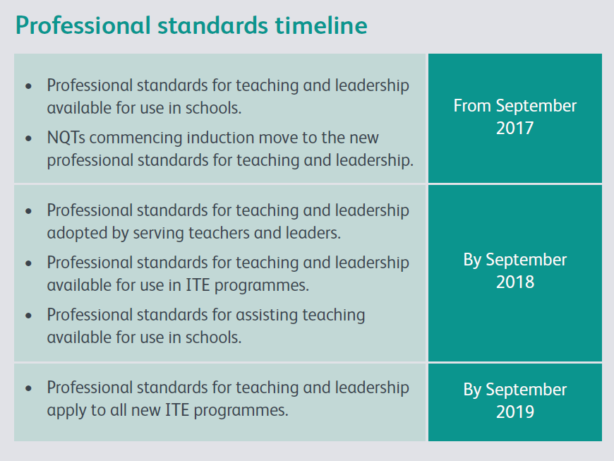

Slide 53
The new professional standards…
As heads we also need to recognise our responsibility to the whole system, to pupils who are not just the ones in our own schools. In terms of moral purpose we should be talking about making sure it is right for every pupil in every school. Where the academy could help is to put the focus on doing fewer things well and releasing us from what may be stifling the freedom to innovate.
Head teacher comment at leadership seminar, 2018

Slide 54
The new professional standards…
I am in the best job in the world! I absolutely believe that, I am honoured to get up every day and go to school. I have clear expectations laid on me by my governing body and they support me in setting a work/life balance. You have to balance what is expected of you with what is realistic, achievable. I don’t fear the word accountability because I believe I have got the right definition, my own definition. It is about how we celebrate what is vital to the functioning of the school.
Head teacher comment at leadership seminar, 2018

